Slide 1

August 2017

Slide 2

Agenda
Welcome to the Seattle ColdFusion User Group
Introductions
Goals
Adobe ColdFusion Developer Week
ColdFusion Frameworks
ColdFusion Resources & Upcoming Events
Social Media/On-line Resources
Web Site Coming Soon
Volunteer Opportunities
Next Month’s Meeting

Slide 3
Ajax, Cold Fusion
& Google Maps
Presenter (who is this guy?)
  Jim Schell
    Principal of My Fire Rules
      aka the Rules Evangelist
    Fire Fighter for City of Tukwila
    Self taught no formal training

Slide 4
Development Environment
Eclipse 4.5.2 (mars version 2) with the following libraries
  Cf 2016
  Bootstrap 3.3.7
  Jquery 3.2.1
  Jqwidgets 5.1
  Googlemaps api 3.0

Slide 5
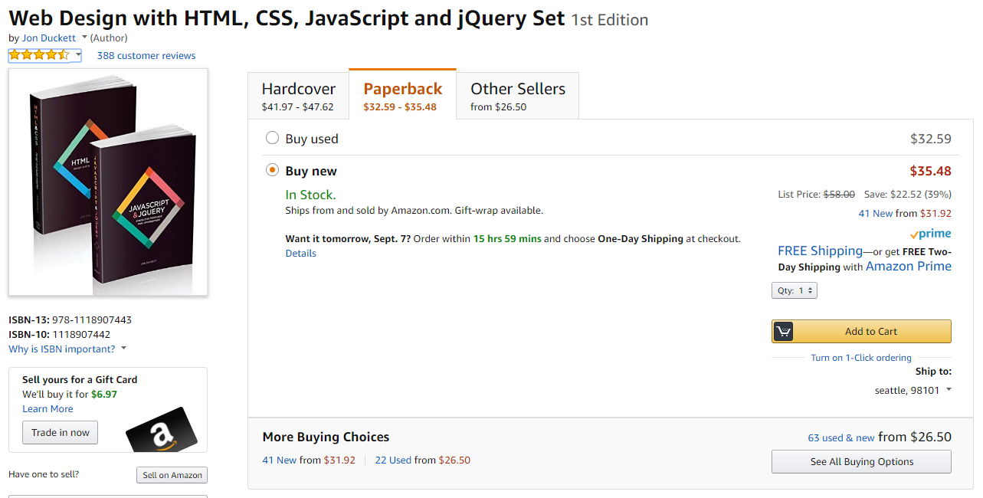
Books Used

Slide 6
What is AJAX….
Ajax allows content on Web pages to update immediately when a user performs an action…
  http://searchwindevelopment.techtarget.com/definition/Ajax
Notes:
Ajax (Asynchronous JavaScript and XML) is a method of building interactive applications for the Web that process user requests immediately. Ajax combines several programming tools including JavaScript, dynamic HTML (DHTML), Extensible Markup Language (XML), cascading style sheets (CSS), the Document Object Model (DOM), and the Microsoft object, XMLHttpRequest.
Ajax allows content on Web pages to update immediately when a user performs an action, unlike an HTTP request, during which users must wait for a whole new page to load. For example, a weather forecasting site could display local conditions on one side of the page without delay after a user types in a zip code.
Google Maps is one well-known application that uses Ajax. The interface allows the user to change views and manipulate the map in real time. Ajax applications do not require installation of a plug-in, but work directly with a Web browser. Because of the technique's reliance on XMLHttpRequest, early applications worked only with Microsoft's Internet Explorer browser, but most other browsers now support Ajax.
Applications created with Ajax use an enginethat acts as an intermediary between a user's browser and the server from which it is requesting information. Instead of loading a traditional Web page, the user's browser loads the Ajax engine, which displays the page the user sees. The engine continues to run in the background, using JavaScript to communicate with the Web browser. User input or clicking on the page sends a JavaScript call to the Ajax engine, which can respond instantly in many cases. If the engine needs additional data, it requests it from the server, usually using XML, while it is simultaneously updating the page.
Ajax is not a proprietary technology or a packaged product. Web developers have been using JavaScript and XML in combination for several years. Jesse James Garrett of the consultancy firm Adaptive Path is credited with coining the name "Ajax" as a shorthand way to refer to the specific technologies involved in a current approach.

Slide 7
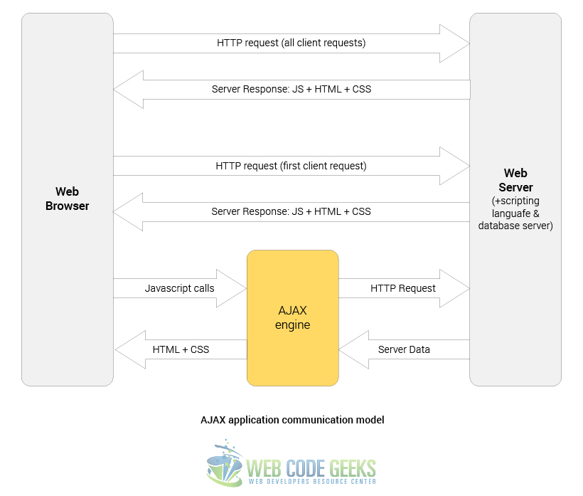
AJAX Communication…
Classic web app communication model
https://www.webcodegeeks.com/javascript/jquery/jquery-ajax-example/
AJAX web app communication model

Slide 8
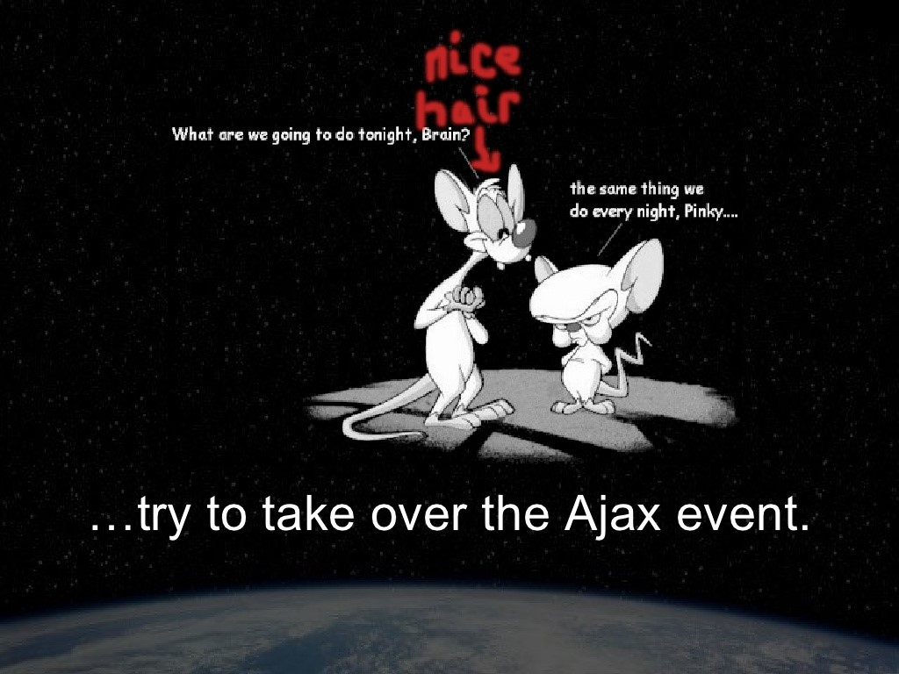
Re: https://www.slideshare.net/shadedecho/extending-ajax-events-for-all-mankind

Slide 9
JQuery Ajax Events
ajaxStart (Global Event)
This event is triggered if an Ajax request is started and no other Ajax requests are currently running.
  beforeSend (Local Event)
  This event, which is triggered before an Ajax request is started, allows you to modify the XMLHttpRequest object (setting additional headers, if need be.)
  ajaxSend (Global Event)
  This global event is also triggered before the request is run.
  success (Local Event)
  This event is only called if the request was successful (no errors from the server, no errors with the data).
  ajaxSuccess (Global Event)
  This event is also only called if the request was successful.

Slide 10
JQuery Ajax Events part 2
  error (Local Event)
  This event is only called if an error occurred with the request (you can never have both an error and a success callback with a request).
  ajaxError (Global Event)
  This global event behaves the same as the local error event.
  complete (Local Event)
  This event is called regardless of if the request was successful, or not. You will always receive a complete callback, even for synchronous requests.
  ajaxComplete (Global Event)
  This event behaves the same as the complete event and will be triggered every time an Ajax request finishes.
ajaxStop (Global Event)
This global event is triggered if there are no more Ajax requests being processed
Re: http://api.jquery.com/Ajax_Events/

Slide 11
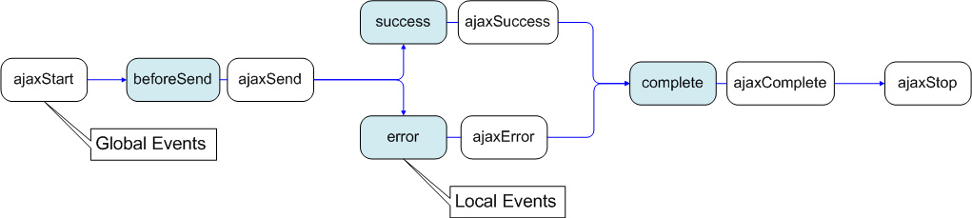
AJAX Events Explained…
Re: https://stackoverflow.com/questions/1021062/use-success-or-complete-in-ajax-call

Slide 12
AJAX Function Sample
var loadLB = function () {
$.ajax({
type: "post",
url: "assets/cfc/inspRotation.cfc",
dataType: "json",
data:{
method: "getInspDates",
SS: $("#inspAssignment").val()
},
error: function (json, textStatus, errorThrown) {
alert(' Error :' + errorThrown);
},
success: function (data){
// prepare the data
var lbData=data;
var sourceLB =
{
localdata: lbData,
datatype: "json",
dataFields: [
{ name: 'ASG_MONTHYEAR', type: "string" },
{ name: 'INSPDATE', type: "string" }
],
id:'ASG_MONTHYEAR'
};
// create data adapter
var dataAdapterLB = new $.jqx.dataAdapter(sourceLB);
// create list box
$("#inspDateLB").jqxListBox({
source: dataAdapterLB,
theme: 'darkblue',
displayMember: "INSPDATE",
valueMember: "ASG_MONTHYEAR",
width: 200,
height: 125
});
}
});
}
Notes:
Use post since does not cache

Slide 13
AJAX Function Sample
var getInspections = function () {
$.ajax({
type: "post",
url: "assets/cfc/inspRotation.cfc",
dataType: "json",
data: {
method: "getInspList",
SS: $("#inspAssignment").val(),
ASG: $("#inspDateLB").val()
},
error: function (json, textStatus, errorThrown) {
alert(' Error :' + errorThrown);
},
success: function (data){
// begin google map code
// default google map options
var myOptions = {
center: new google.maps.
LatLng(47.455863, -122.254503),
zoom: 14,
mapTypeId: google.maps.MapTypeId.ROADMAP
};
map = new google.maps.Map(document.
getElementById("map"), myOptions);
var ltlng = [];
var latlngbounds = new
google.maps.LatLngBounds();
if (data){
for (var i = 0, length = data.length; i < length; i++) {
var jsn = data[i],
latLng = new google.maps.LatLng(
jsn.LATITUDE, jsn.LONGTITUDE);
latlngbounds.extend(latLng);
// Creating a marker and put it on the map
var marker = new google.maps.Marker({
position: latLng,
map: map,
title: jsn.NAME+': '+jsn.LOCATION
});
}};
// adjust google map bounds to fit all markers
map.fitBounds(latlngbounds);
// end google map code
// prepare the data
var latData=data;
var sourceLatGrid =
{
localdata: latData,
datatype: "json",
dataFields: [
{ name: 'OCCID',
type: "string" },
{ name: 'OCCUPANCY',
type: "string" }
],
id:'OCCID'
};
// create data adapter
var latDataAdapterGrid = new
$.jqx.dataAdapter(sourceLatGrid);
// create data grid
$("#latGrid").jqxGrid({
source: latDataAdapterGrid,
theme: 'darkblue',
width: 350,
height: 350,
columnsresize: true,
columns: [
{ text: 'Occid', datafield: 'OCCID',
width: 50 },
{ text:'Name/Address',
datafield: 'OCCUPANCY‘,
width: 350 }
]
});
// get data without latitude value
getNoLat();
}
});
}

Slide 14
Cold Fusion CFC Anatomy 101
CFC Layout
  Header comments
  Component
  Functions
    Use a consistent formatting of your functions so that you can debug easier

Slide 15
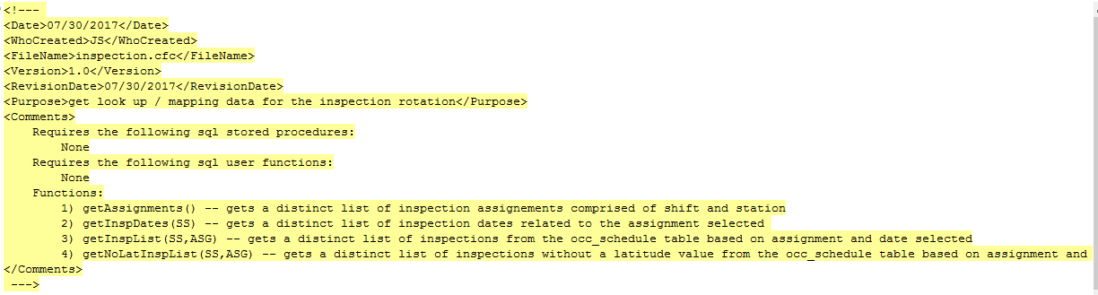
CFC Anatomy
Header Comments
Component
  only one per cfc but can have multiple functions within

Slide 16
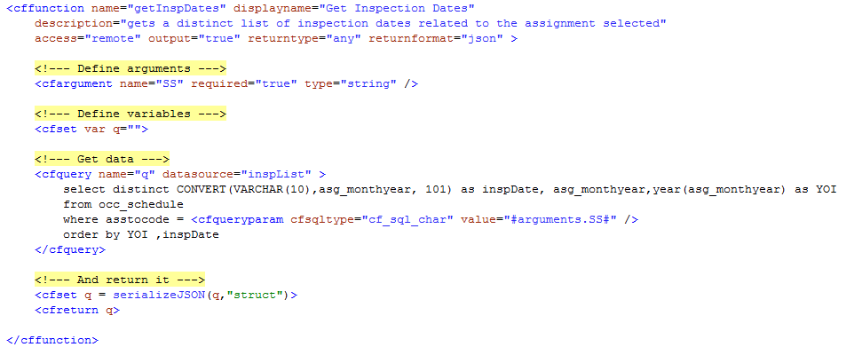
CFC Anatomy In-line SQL
Sample cffunction
Notes:
Access = remote is critical for web apps, Returntype = any, Returntype = json, used in conjunction with serializeJSON in a struct, queryparam

Slide 17
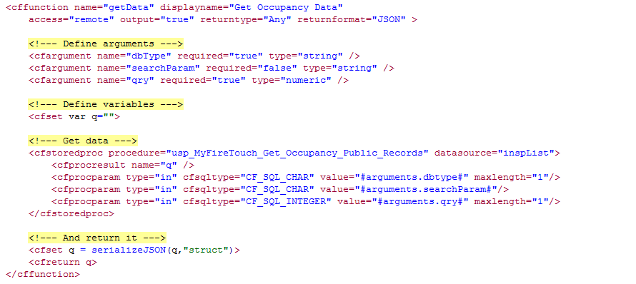
CFC Anatomy Stored Proc
Stored procedures….

Slide 18
SQL Injection Safety Net
In Line SQL
  cfqueryparam
Stored Procedures
  cfprocparam
USE THEM THEY WILL HELP PREVENT SQL INJECTION ATTACKS!!!!!!!!!!!!
Consider not allowing free form text search fields, if you do then test the text first before you send it against your live tables

Slide 19
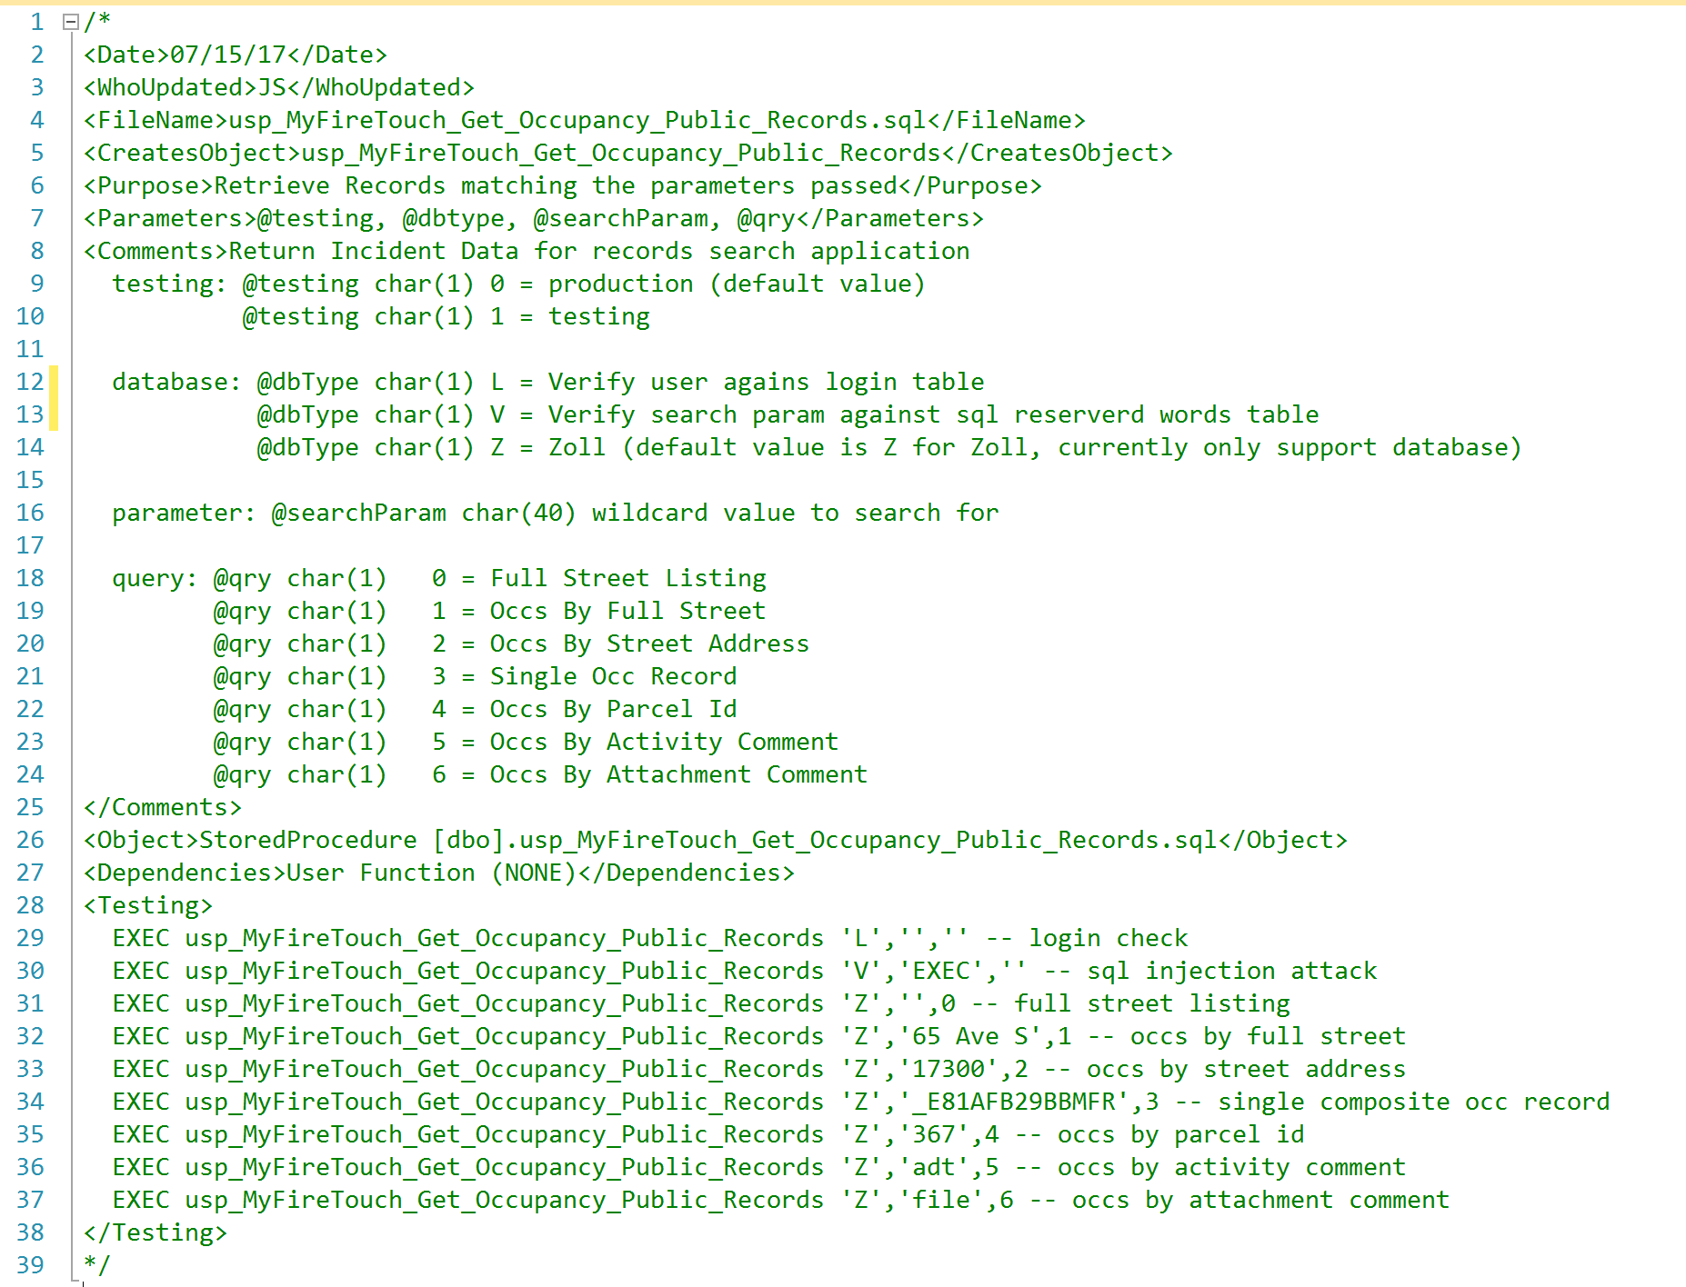
Stored Procedure Anatomy
Header comments
Structured and clean

Slide 20
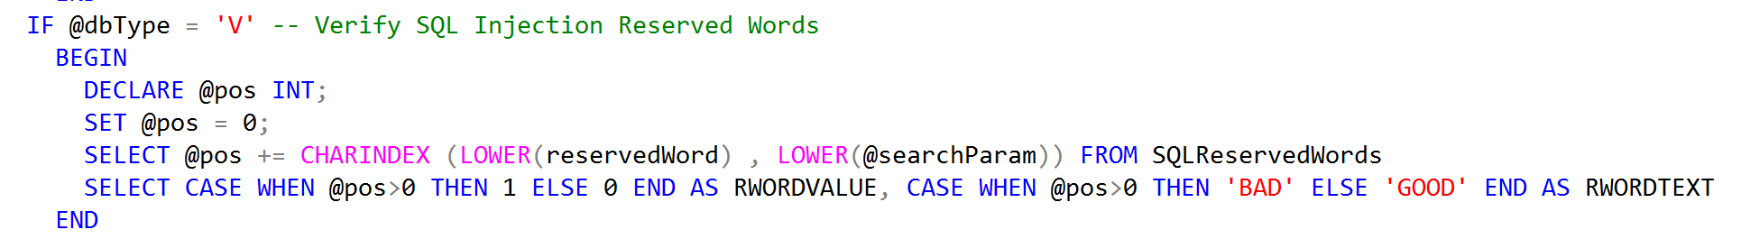
SQL Stored Procedures…
Code snippet of a parameter based SQL stored procedure:

Slide 21
AJAX to SQL and back…
Ajax calls the Cold Fusion CFC sending parameters as needed
Cfc calls SQL stored procedure sending parameters as needed
SQL Stored Procedure processes function based on parameters supplied by the CFC
SQL returns the data to the CFC
CFC processes data and returns data to the AJAX call
AJAX events are processed based on the data returned and makes additional calls if needed

Slide 22
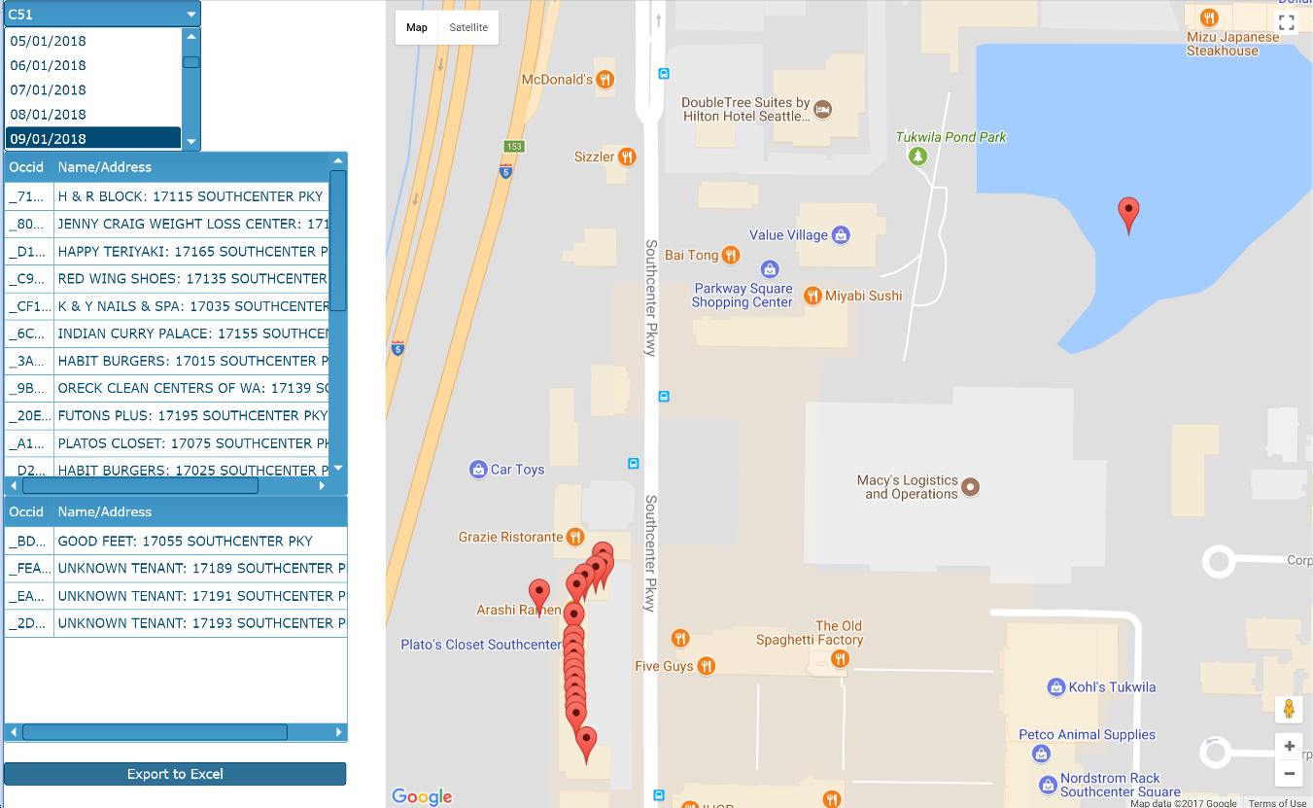
DEMO TIME!!!!
Sample application for Tukwila Fire Dept.
  Shows monthly inspection locations
  Incorporates
    HTML
    CFML
    CSS
    Javascript
    AJAX / JQUERY
    JQWIDGETS
    Bootstrap
    Google Map API

