Slide 1
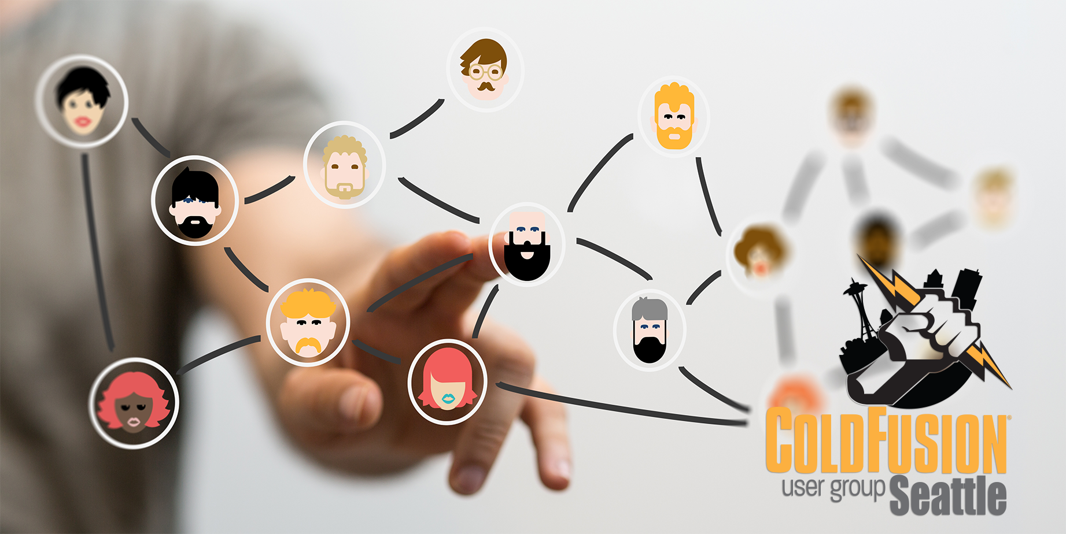
May
2019

Slide 2
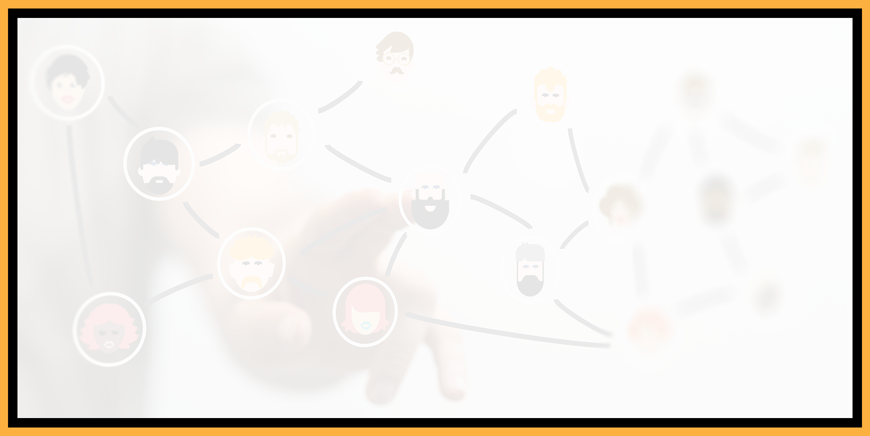
Agenda
Introductions
Goals
Add Your Bio to the Seattle CFUG site
Registration for CF Summit 2019 now open
Cut Root-Cause Analysis Time down from days to minutes using FusionReactor
Next Meeting
Questions/Answers/Help Needed

Slide 3
Introductions
Tell us a little bit about who you are
Share with us what you would like to get from this user group

Slide 4
Goals
Assist ColdFusion Developers Throughout the
Pacific Northwest
Promote ColdFusion Developers Throughout the
Pacific Northwest
Connect Employers with ColdFusion Developers
Establish a Community of Friendship Between ColdFusion Developers
Provide Speaking Opportunities for ColdFusion Developers
Change the Perception of ColdFusion as a viable platform

Slide 5
CF Summit 2019
September 30 – October 2, 2019 at the Mirage Resort and Casino, Las Vegas
Early-Bird Registration of $99.00 through May 31st
Adobe ColdFusion Specialist Certification Program/Test on September 30th: https://cfsummit.adobeevents.com/adobe-coldfusion-specialist/
Now available for registration at https://cfsummit.adobeevents.com

Slide 6
Cut Root-Cause Analysis Time down from days to minutes using FusionReactor
Presentation by Charlie Arehart

Slide 7
Next Month’s Meeting
June 12, 2019
This meeting features presentations by Himanshu Shekkar on the ColdFusion API Manager and by Adnan Mehanovic on ColdFusion security.
Zoom link: https://zoom.us/j/801255077

Slide 8
Questions/Answers/Help!

