Slide 1
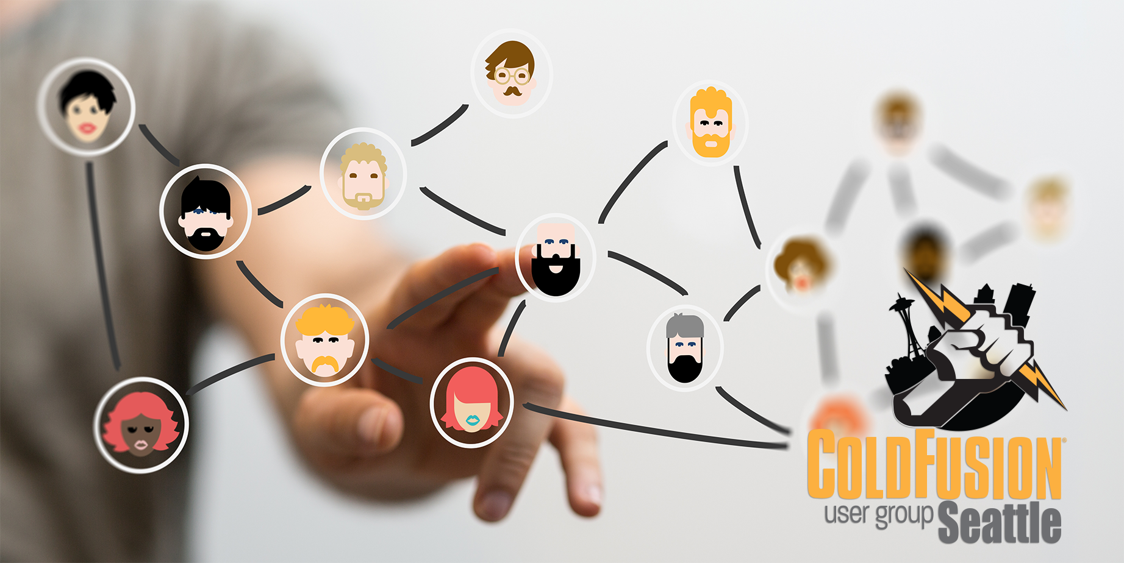
March 2020

Slide 2
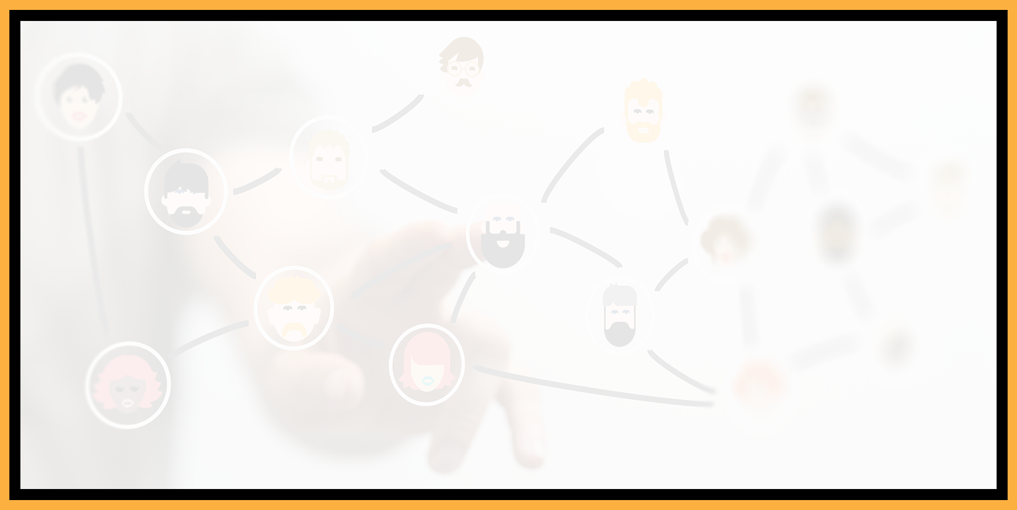
Agenda
Introductions
Goals
Add Your Bio to the Seattle CFUG site
Adobe ColdFusion Updaters Available
Upcoming Event: Microservices Architecture: Trends and Challenges
Discussion: 2020 Goals and Objectives for the Seattle CFUG
Questions/Answers/Help Needed
Next Meeting

Slide 3
Introductions
Tell us a little bit about who you are
Share with us what you would like to get from this user group

Slide 4
Goals
Assist ColdFusion Developers Throughout the
Pacific Northwest
Promote ColdFusion Developers Throughout the
Pacific Northwest
Connect Employers with ColdFusion Developers
Establish a Community of Friendship Between ColdFusion Developers
Provide Speaking Opportunities for ColdFusion Developers
Change the Perception of ColdFusion as a viable platform

Slide 5
Add Your Bio to the Seattle ColdFusion User Group site
Let prospective employers know you’re available for ColdFusion Support
Include your photo, biography, social media links and e-mail address
Available for any active Seattle ColdFusion User Group member (attendance at a Seattle ColdFusion User Group Meeting in the past 3 months). Don’t need to be a resident in the Pacific Northwest,

Slide 6
Adobe ColdFusion
Updaters Available
ColdFusion (2018 release) Update 8 and ColdFusion (2016 release) Update 14 released.
Updates, Technicial Notes and Docker Images are available from https://coldfusion.adobe.com/2020/03/coldfusion-2018-release-update-8-coldfusion-2016-release-update-14-released/

Slide 7
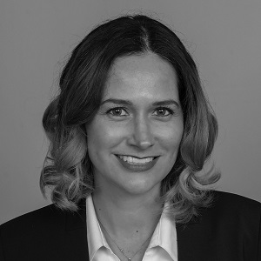
Upcoming Event
Microservices Architecture: Trends and Challenges
Date: March 25, 2020 - 9 am PDT
Presenter: Elishia Dvorak - Technical Marketing Manager at Adobe supporting both eLearning and ColdFusion product lines
What this session will cover:
  Discussion on microservices trends, architecture, and challenges.
  Review some of the current trends in microservices architecture with a focus on existing application transformation and challenges.
More info and register: https://cfwebinar-trends.meetus.adobeevents.com/

Slide 8
Discussion: 2020 Goals and Objectives for the Seattle CFUG
Where would you like to see our user group focus in 2020?

Slide 9
Discussion: 2020 Goals and Objectives for the Seattle CFUG
What presentations would you like to see in 2020?

Slide 10
Discussion: 2020 Goals and Objectives for the Seattle CFUG
Would you like to see presentations surrounding, but not specific to ColdFusion sprinkled in during meetings?

Slide 11
Discussion: 2020 Goals and Objectives for the Seattle CFUG
Would you be interested in presenting at an upcoming user group meeting?

Slide 12
Discussion: 2020 Goals and Objectives for the Seattle CFUG
Would you be interested in leading an upcoming user group meeting?

Slide 13
Discussion: 2020 Goals and Objectives for the Seattle CFUG
Would you be interested in leading our user group?

Slide 14
Questions/Answers/
Help Needed
This is your opportunity to ask any ColdFusion question or request help for a ColdFusion-related issue.

Slide 15
Next Meeting
April 15th or 22nd, 2020 – 6:00 PM PST (on-line via Zoom).

