Slide 1

July
2026

Slide 2

Agenda
Welcome
ColdFusion 2023 – Update 22 and ColdFusion 2025 – Update 11
New AI-enabling features in ColdFusion 2025 Update 8
ColdFusion Builder for VS Code Update 5
Adobe ColdFusion Summit 2026 Recap
Securing Your ColdFusion Data Sources
New ColdFusion Training Available
Questions/Answers/Help Needed
Next Meeting

Slide 3
ColdFusion 2023 – Update 22 & ColdFusion 2025 – Update 11
Release Date: July 14, 2026
What does it resolve? Critical, important, and moderate vulnerabilities that could lead to arbitrary code execution, privilege escalation, arbitrary file system read, and security feature bypass.
More Info: CF 2025 – Update 11 | CF 2023 – Update 22

Slide 4
New AI-enabling features in ColdFusion 2025 Update 8
ColdFusion 2025 – Update 8 update introduces the following AI-enabling features:
Native AI and LLM integration
Model Context Protocol (MCP) support
Vector stores and Retrieval Augmented Generation (RAG)
AI guardrails in agent() to filter LLM inputs and outputs via CFC-based validators
AI Development Support in ColdFusion Builder for Visual Studio Code
AI services monitoring in PMT (Performance Management Tool)
More Info: What’s New in ColdFusion 2025 – Update 8

Slide 5
New AI-enabling features in ColdFusion 2025 Update 8
Native AI and LLM integration
You can choose the LLM of your choice from:
OpenAI, Anthropic, Mistral, Google Gemini, and Ollama
More info: Introduction to models in ColdFusion

Slide 6
New AI-enabling features in ColdFusion 2025 Update 8
Model Text Protocol (MCP) Support
Model Context Protocol (MCP) is an open standard for connecting AI models to external systems. It provides a controlled interface layer between an AI agent and your application, giving agents the ability to discover and use tools without unrestricted access to your codebase.
ColdFusion 2025 update 8 supports MCP in both directions as client and server.
More info: MCPs in ColdFusion

Slide 7
New AI-enabling features in ColdFusion 2025 Update 8
Vector Stores and Retrieval Augmented Generation (RAG)
ColdFusion 2025 update 8 adds a native RAG pipeline that grounds AI responses in your own content.
It supports five vector stores (InMemory, Pinecone, Milvus, Qdrant, Chroma) and offers three approaches: simpleRAG() for quick setup, agent() with INGESTION for full pipeline control in production, and documentService() for scheduled or shared ingestion jobs.
More info: RAG in ColdFusion | Vector Stores and Embedding

Slide 8
New AI-enabling features in ColdFusion 2025 Update 8
Embedding Models
An embedding model is a specialized machine learning component in Retrieval-Augmented Generation (RAG) that translates natural language into numerical arrays called vectors. It acts as a bridge between human text and a database, capturing the core semantic meaning and context of words and paragraphs.
ColdFusion 2025 – Update 8 (and beyond) offers the following Embedding Model options:
OpenAI, Azure Open AI Service, Mistral AI, Ollama, Gemini, and
All-MiniLM (local)

Slide 9
New AI-enabling features in ColdFusion 2025 Update 8
AI guardrails in agent() to filter LLM inputs and outputs via CFC-based validators
Large Language Models (LLMs) can produce harmful, insecure, or non‑compliant outputs if left ungoverned.
Shoppers could enter a prompt to apply a 100% discount to an order
Users can attempt to override your system instructions (for example, “ignore previous instructions” or “reveal your internal rules”) and change how the model behaves
Users may submit, or the model may generate, content involving self‑harm, hate speech, violence, criminal instructions, or other violative material. policy‑violating material.

Slide 10
New AI-enabling features in ColdFusion 2025 Update 8
AI guardrails in agent() to filter LLM inputs and outputs via CFC-based validators
ColdFusion introduces guardrails: developer‑defined validation components that run before and after LLM calls.
Guardrails allow ColdFusion applications to enforce security, safety, and AI ethics policies in a way that is explicit, testable, and under your control.
More info: Guardrails for AI Ethics and Safety

Slide 11
New AI-enabling features in ColdFusion 2025 Update 8
AI guardrails in agent() to filter LLM inputs and outputs via CFC-based validators
ColdFusion introduces guardrails: developer‑defined validation components that run before and after LLM calls.
Guardrails allow ColdFusion applications to enforce security, safety, and AI ethics policies in a way that is explicit, testable, and under your control.
More info: Guardrails for AI Ethics and Safety

Slide 12
New AI-enabling features in ColdFusion 2025 Update 8
AI services monitoring in PMT (Performance Management Tool)
PMT now includes an AI Services dashboard (enabled via Settings > Monitoring > Advanced) with seven tabs covering every layer of the AI stack; LLMs, Agents, RAG, MCP Clients, MCP Servers, Vector Stores, and a Trace Viewer that shows a full flamegraph of each AI request to pinpoint pipeline bottlenecks.
More info: AI Services Monitoring in PMT

Slide 13
ColdFusion Builder Updates
CF Builder Extension for VS Code Updated for ColdFusion 2025 – Update 8
Now supports Linux and Docker (as a first-class server target with full RDS/debugger support)
Rebuilt context-aware CFML grammar that no longer breaks syntax highlighting on mixed-language files
Code completions for AI, Cloud, and MongoDB services with deprecation warnings
Improved Security Analyzer with new rules, better performance on large codebases, and PDF/CSV export.
More info: What’s New/Changed in CF Builder Update 5

Slide 14
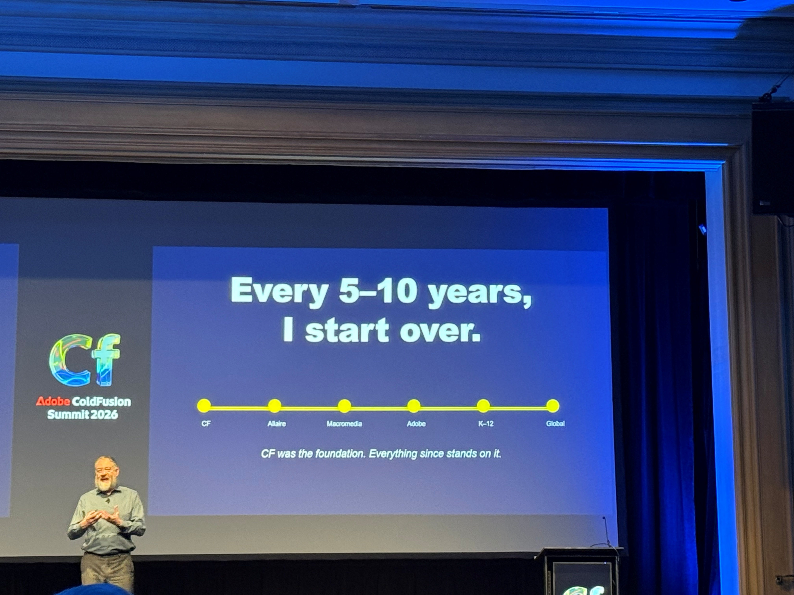
Adobe ColdFusion Summit 2026 Recap Takeaways
Ben Forta Keynote!
Decide if your application really needs AI before making it AI-enabled
AI Workshop was terrific – 2 sessions – each a day long
The Bellagio was a great host for CF Summit
Magic Links, and Passkeys, and SSO, oh my! session – none of these are a silver bullet (but they are better than passwords)

Slide 15
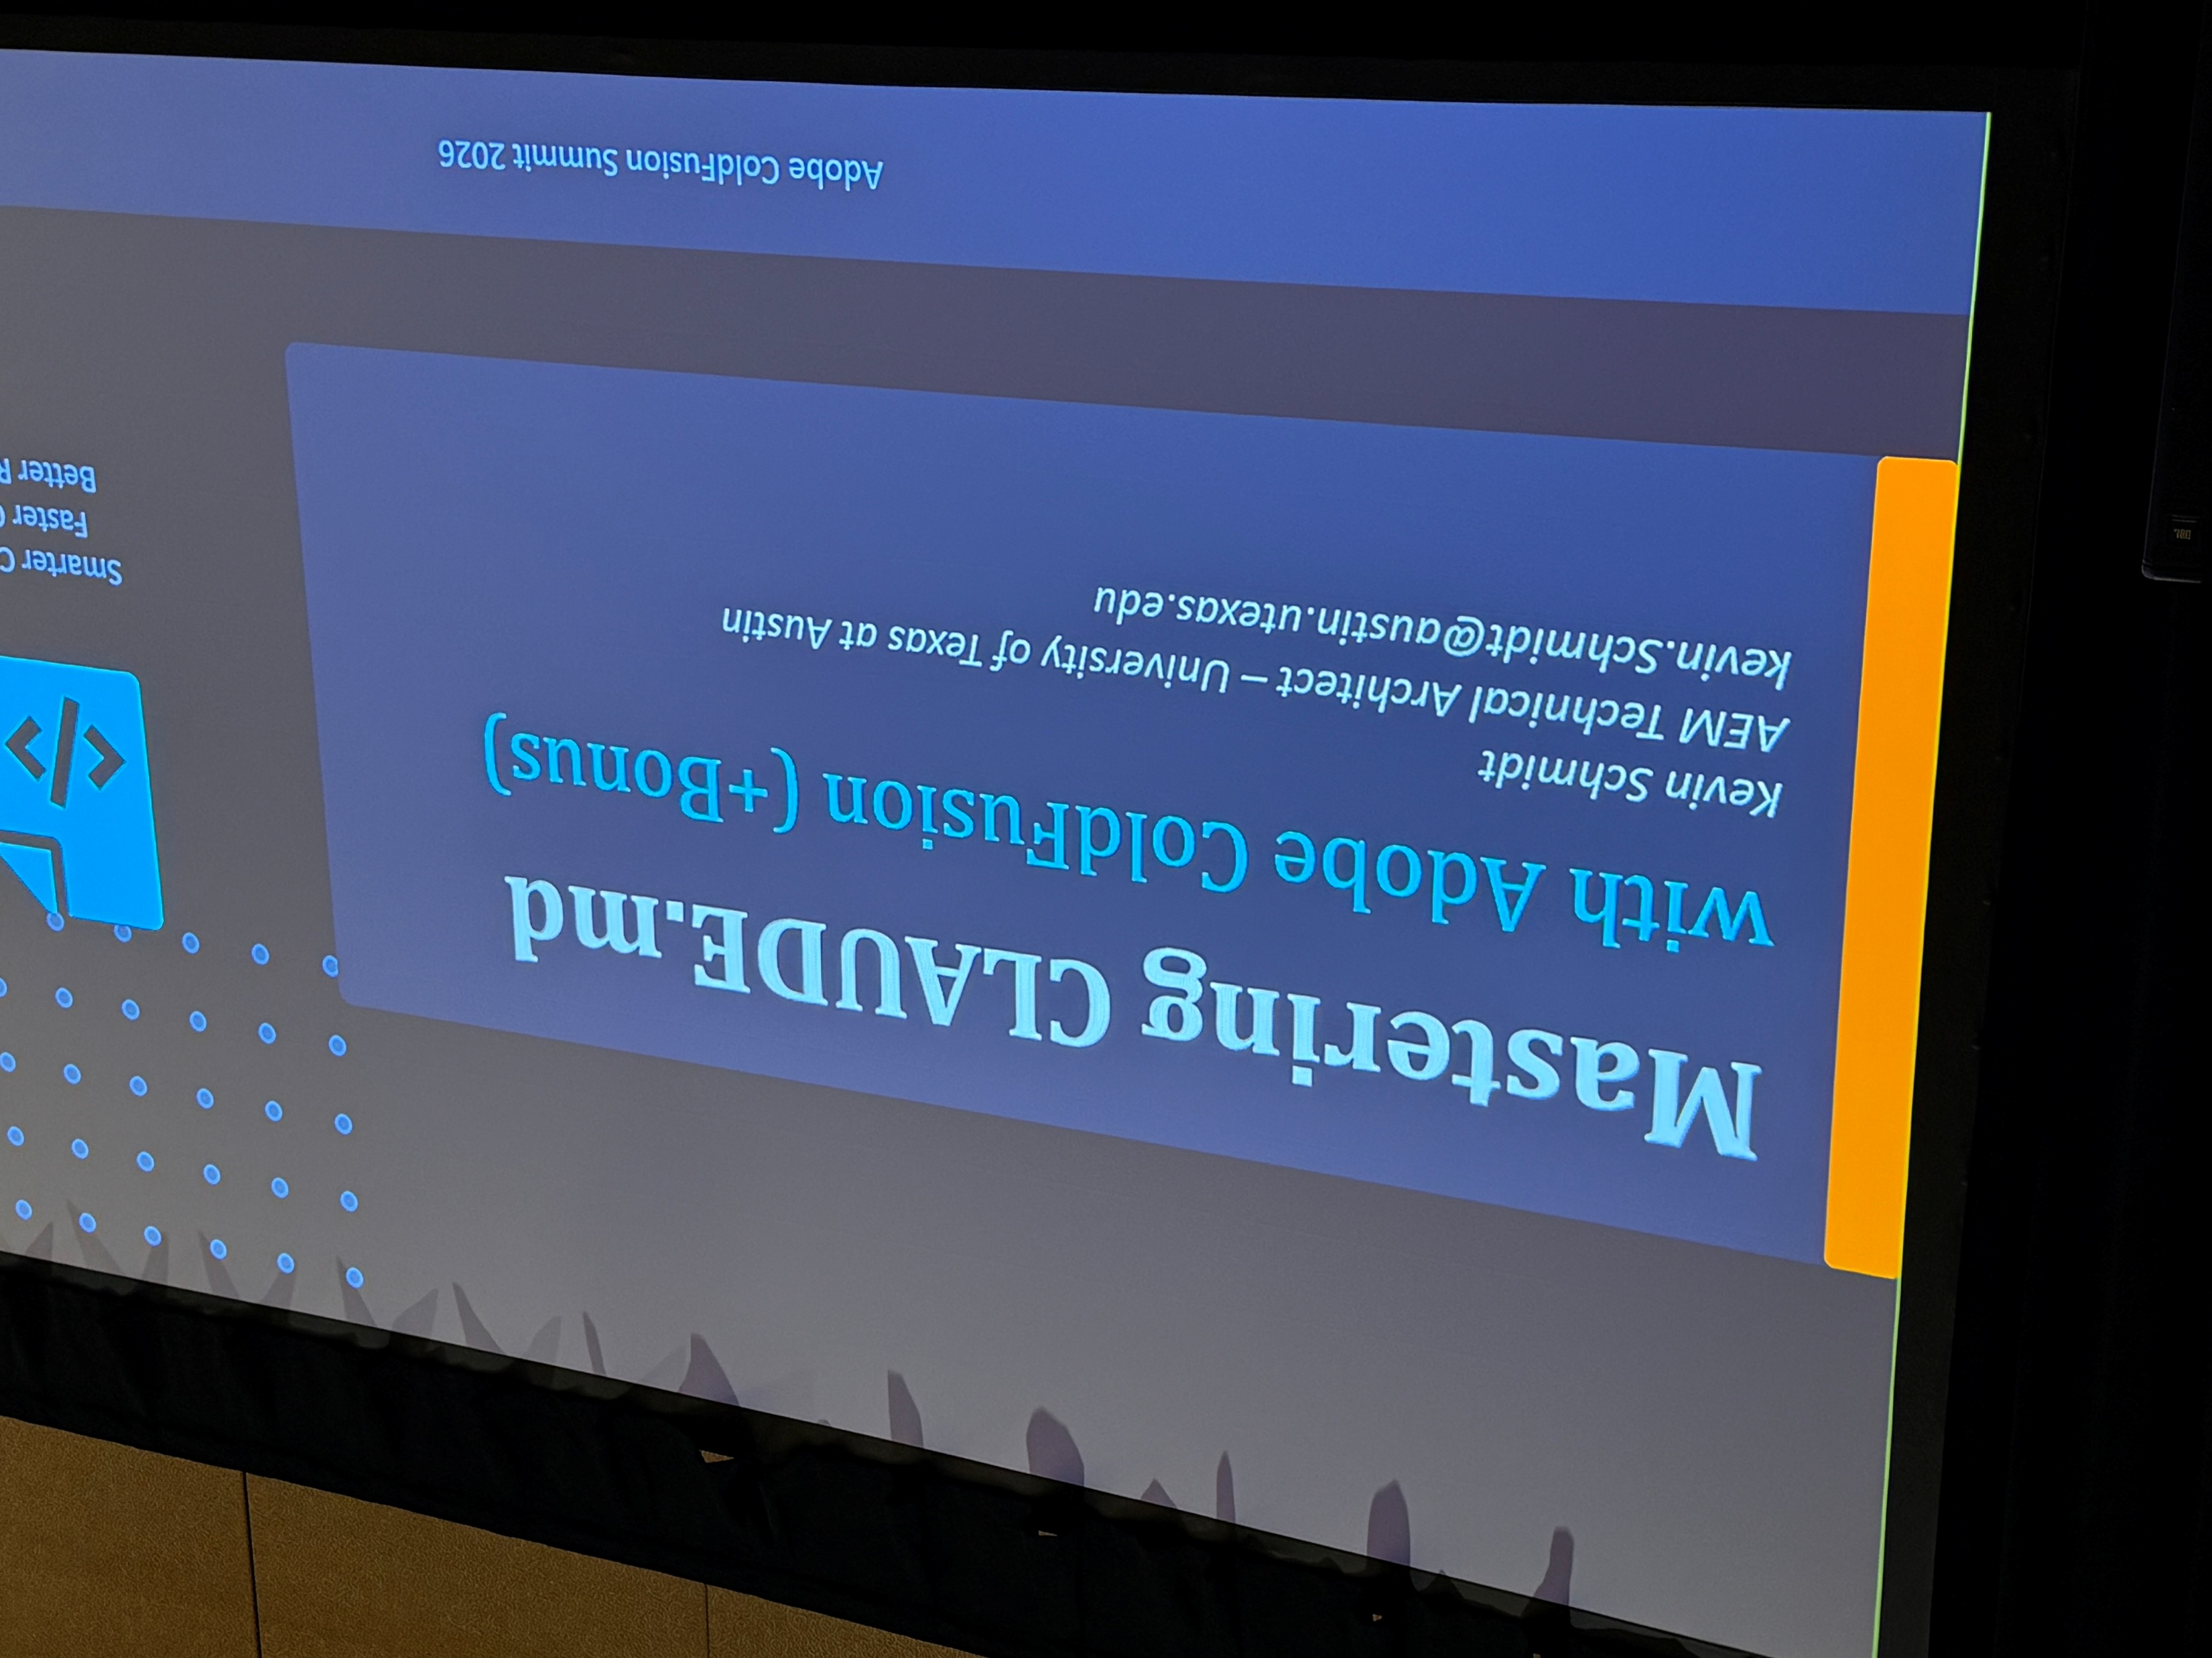
Adobe ColdFusion Summit 2026 Recap Takeaways
Update your ColdFusion Builder Extension! but also now available on Cursor, not just VSCode https://coldfusion.adobe.com/2026/06/now-live-adobe-coldfusion-builder-is-now-available-on-cursor/
Nolan Erck and others came out with lightweight MVC for CFML called Ziggy MVC https://ziggymvc.github.io/
Using Claude or KIRO, create a ColdFusion Steering file!

Slide 16
Adobe ColdFusion Summit 2026 Recap
Users received:
  Free 1 year license to Adobe ColdFusion 2025 Standard

Slide 17
Securing Your ColdFusion Data Sources
Presenter:
William Frankhouser
Senior Web Application Developer
Boeing Commercial Airplanes Digital Engineering

Slide 18
New ColdFusion Training Available
ColdFusion Community Portal – Getting Started
Adobe ColdFusion YouTube Channel
Adobe ColdFusion – Learn and Support
Adobe ColdFusion User Guides
Adobe ColdFusion Learning Hub

Slide 19
Questions/Answers/
Help Needed
This is your opportunity to ask any ColdFusion question or request help for a ColdFusion-related issue.

Slide 20
Next Meeting
July 16, 2025 – 5:00 PM PDT (online via Zoom).
Using Cloudflare turnstile and Managed Firewall Rules to secure your login pages and reduce contact form SPAM
Leon O’Daniel – The Boeing Company/O’Daniel Creative
  How to implement CloudFlare turnstile to reduce Contact Form SPAM and prevent BOTS from submitting your login pages
  How to use Managed Firewall Rules in Cloudflare to implement managed challenges
ColdFusion Tag/Function O’ Month
Will Frankhouser – The Boeing Company/Wilz Dezign

