Slide 1

July 2018

Slide 2

Agenda
Welcome to the Seattle ColdFusion User Group
Introductions
Goals
Upcoming ColdFusion Events
Add Your Bio to the Seattle CFUG site
CFSpreadsheet demo by William Frankhouser of
Everett CC / WilzDezign
Fun with PDFs and ColdFusion by Jim Bates of
Cherwell Software / Latreia
Get Your Questions Answered. Ask the Group!
Next Month’s Meeting

Slide 3
Introductions
Tell Us a Little About You
Your name
Where You Work/What You Do
What You’re Hoping to Get From Attending Our User Group Meetings

Slide 4
Goals
Assist ColdFusion Developers Throughout the
Pacific Northwest
Promote ColdFusion Developers Throughout the
Pacific Northwest
Connect Employers with ColdFusion Developers
Establish a Community of Friendship Between ColdFusion Developers
Provide Speaking Opportunities for ColdFusion Developers
Change the Perception of ColdFusion as a viable platform

Slide 5
Upcoming ColdFusion Events
Adobe ColdFusion Summit 2018
Hard Rock Hotel and Casino – Las Vegas
October 1st – 3rd
Register at https://cfsummit.adobeevents.com/register/
Announce Pricing (until Jun 30th) - $249.00
Advance Pricing (until Aug 31st) - $349.00
Full Price (Sep 1 to Oct 3rd) - $399.00

Slide 6
CF Spreadsheet Basics
William Frankhouser
Everett CC / Wilz Dezign

Slide 7
CF Basics - CFSpreadsheet
Goal to create and update easy to use spreadsheets for reports with simple formatting using <cfspreadsheet>
Functionality existed before using drivers, parsing of data, changing MIME type and using cfheader to export the data out.
Adobe introduced CFSpreadsheet in ColdFusion 9
Minor attribute updates in 9.0.1 and 11 added autosize
Not Supported in Lucee
However, extension available for Lucee 5 via Leftbower

Slide 8
CFSpreadsheet Basics
READ a Spreadsheet
UPDATE a Spreadsheet
WRITE a Spreadsheet

Slide 9
CFSpreadsheet READ
<cfspreadsheet
action="read"
src = "filepath"
columns = "range"
columnnames = "comma-delimited list"
excludeHeaderRow = "true | false"
format = "CSV|HTML"
headerrow = "row number"
name = "text"
query = "query name"
rows = "range"
sheet = "number"
sheetname = "text">

Slide 10
CFSpreadsheet UPDATE
<cfspreadsheet
action="update"
filename = "filepath"
format = "csv"
name = "text"
password = "password"
query = "query name"
sheetname = "text" >

Slide 11
CFSpreadsheet WRITE
<cfspreadsheet
action="write"
filename = "filepath"
format = "csv"
name = "text"
overwrite = "true | false"
password = "password"
query = "queryname"
sheetname = "text"
autosize = "true | false" >

Slide 12
CFSpreadsheet Functions
Full Function List
Add
  SpreadSheetAddAutofilter, SpreadsheetAddColumn, SpreadsheetAddFreezePane, SpreadsheetAddImage, SpreadsheetAddInfo, SpreadSheetAddPagebreaks, SpreadsheetAddRow, SpreadsheetAddRows, SpreadsheetAddSplitPane
Create
  SpreadsheetCreateSheet
Delete
  SpreadsheetDeleteColumn, SpreadsheetDeleteColumns, SpreadsheetDeleteRow, SpreadsheetDeleteRows
Format
  SpreadsheetFormatCell, SpreadsheetFormatCellRange, SpreadsheetFormatColumn, SpreadsheetFormatColumns, SpreadsheetFormatRow, SpreadsheetFormatRows
Plus Many More...

Slide 13
Fun with PDFs
…and Coldfusion
Jim Bates

Slide 14


Overview
What, why and how?
Basic pattern
Four specific functions:
  cfdocument
  cfreport
  cfpdf
  cfpdfform

Slide 15
What and Why?
Use CF to add dynamic data to PDF
  In an MVC world, PDF as the view
Why? Consistent user experience
  Printable
  Emailable
  Offline data storage
Nice formatting
Ubiquitous software

Slide 16
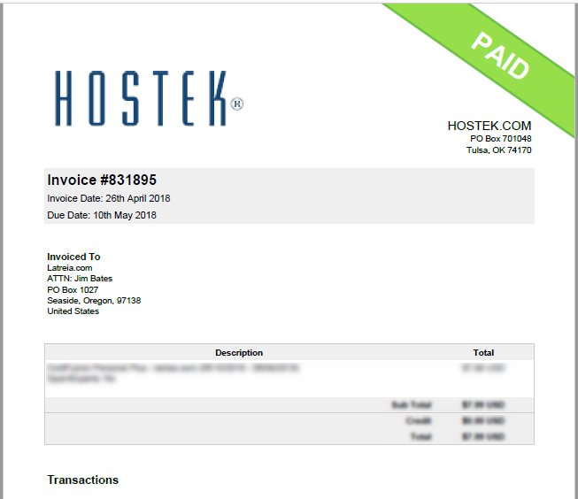
How can you use it?
Invoicing
Customized document creation
  Form letters
  Certificates
Form data import
Reports
  Charts and graphs
  Mailing labels
  Coupons - barcode, QR codes
  Tickets

Slide 17

Basic Pattern
Database
ColdFusion Component
PDF Doc
Form Data
Template Parameters
CF/PDF Parameters
Template
(PDF, HTML+CSS,
CFML, CFR, etc.)
Template Path
Output
Path
Document URL
(DRY)

Slide 18
Tonight’s examples
  PDF publishing using cfdocument
    Simple certificate
  Banded Reports with cfreport
    Avery labels
  PDF concatenation using cfpdf and DDX
    Assemble a brochure
  PDF form data ingestion with cfpdfform
    Feedback form

Slide 19
cfdocument
CFML + CSS to PDF

Slide 20
cfdocument
Use cases
  Certificates, posters, signage
  Output code examples
Anything that:
  Requires consistent UX
  May be printed
  Is distributed digitally

Slide 21
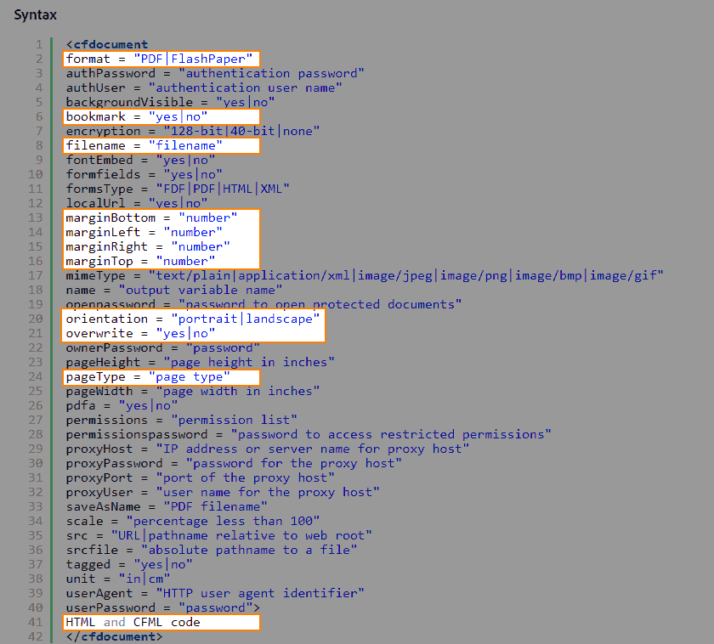
cfdocument
Easiest way to generate PDFs
Block of cfml & html wrapped
in <cfdocument>
Additional feature tags
  <cfdocumentSection>
  Generates page break, formatting,
  gives name for TOC
  <cfdocumentItem>
  Force page break, special header/footer
https://helpx.adobe.com/coldfusion/cfml-reference/coldfusion-tags/tags-d-e/cfdocument.html

Slide 22
cfdocument in cfc function
/**
* @displayname Create Preface
* @hint Generates a personalized Preface
* @description Uses template to generate personalized Preface
* @output false
* @returnFormat json
* @secureJSON yes
* @verifyClient yes
*/
public string function createPreface(required string name, required string template, required any suffix)
{
  var tempPath = instance.tempPath;
  var prefacePath = tempPath & "Preface-#arguments.suffix#.pdf";
  cfdocument( format="pdf", filename=expandPath(prefacePath), overwrite=true, bookmark="yes" ) {
  cfdocumentSection(name="Preface") {
  include "/classes/templates/#arguments.template#";
  }
  }
  return prefacePath;
}

Slide 23
cfdocument in cfc function
<!--- Create Preface --->
<cffunction name="createPreface" access="public" output="false" returntype="string" returnformat="JSON"
hint="Generates a personalized Preface" secureJSON="Yes" verifyClient="Yes">
<cfargument name="name" type="string" required="yes">
<cfargument name="template" type="string" required="yes">
<cfargument name="suffix" type="any" required="yes">
<cfset variables.tempPath = instance.tempPath>
<cfset variables.prefacePath = tempPath & "Preface-#arguments.suffix#.pdf">
<cfdocument format="pdf" filename=prefacePath overwrite=true bookmark="yes">
<cfdocumentSection name="Preface">
  <cfinclude template="/classes/templates/#arguments.template#.cfm">
  </cfdocumentSection>
  </cfdocument >
  <cfreturn prefacePath>
</cffunction>
So where are margins, page type, etc?
Template has defaults
Parameters passed in the Arguments scope are visible to the included template.
So they are passed in via the argumentCollection, and rendered by the <cfoutput> in the template.

Slide 24
practical considerations
Customized filenames need to be unique
  So customer files don’t get muddled
  Use a suffix (random number or datetime) to keep unique
Be sure to include file cleanup
  After timespan – and/or –
  Programmatic: after confirm email sent, etc.
  Serve with cfcontent with deletefile="yes"
I recommend creating a template .cfm, with embedded CSS
  Output whatever variables needed
  Allows separation of concerns ☺

Slide 25
cfdocument vs cfhtmltopdf
cfdocument | cfhtmltopdf
cfdocument supports providing username and password if the source URL is protected through BasicAuth. | No such provision in cfhtmltopdf
cfdocumentsection tag is present | No equivalent of cfdocumentsection in cfhtmltopdf.
You can create bookmarks, for example, <cfdocument bookmark=”yes”> | No bookmark support.
Can work behind a proxy server. | Cannot work behind a proxy server.
https://helpx.adobe.com/coldfusion/kb/differences-cfdocument-cfhtmltopdf.html

Slide 26
cfdocument example
Quick demo:
  Log into http://training.latreia.com as cfug / seattle
  My courses > Fun with PDF
  Click ‘eyecon’ on cfdocument to expand the topic
  Click demo of cfdocument.
Fill in name, select presentation
Click button ‘Make the Certificate!’

Slide 27
cfreport
Banded reports using CF Report Builder

Slide 28
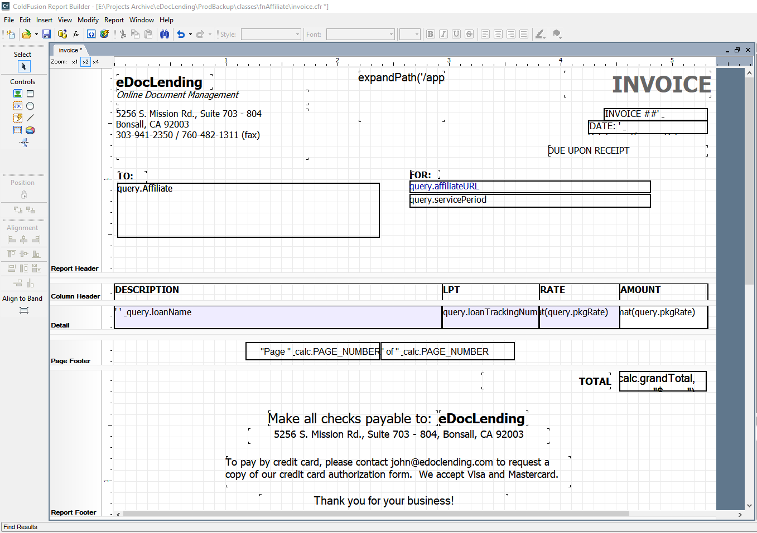
cfreport
In 2005, with ColdFusion MX7,
Macromedia released
ColdFusion Report Builder
  Banded report generator
  Fairly decent
Use query builder
or write custom query
Output is a .cfr template file

Slide 29
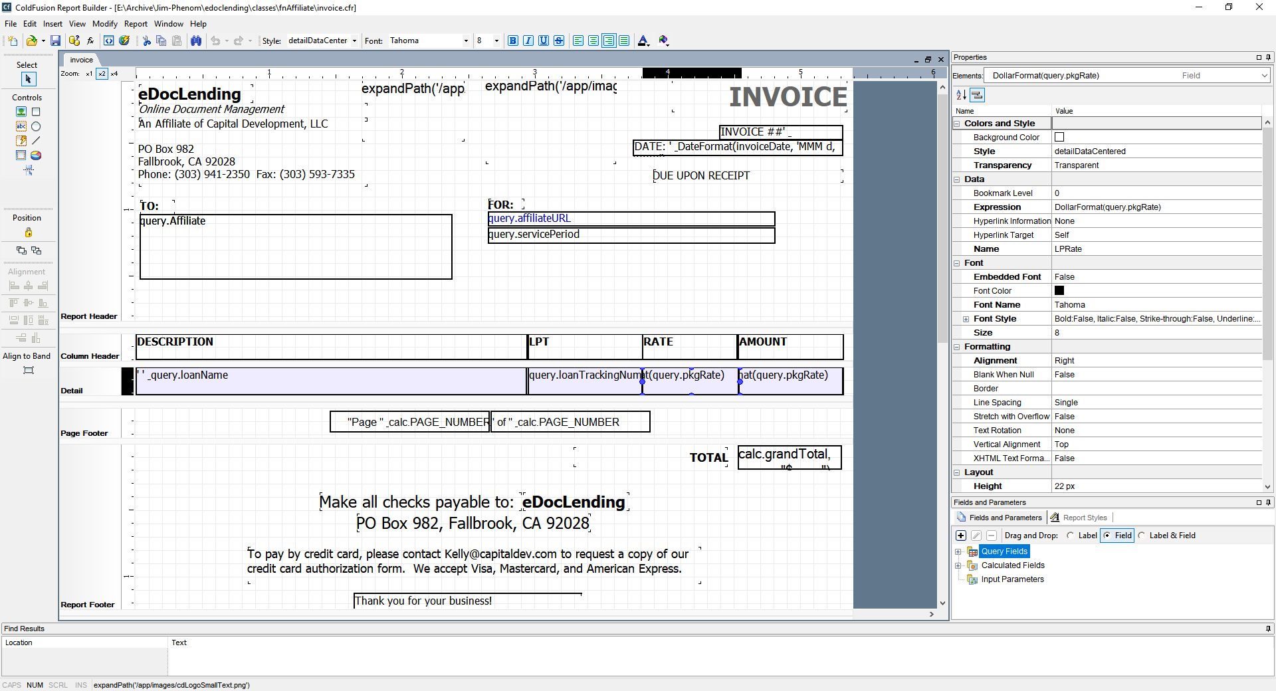

Slide 30
cfreport
Use cases:
  Banded reports
  Invoicing
  Labels
Anything that:
  Has strict format for multiple data elements
  Requires visual presentation of data
  Will be printed and/or distributed digitally

Slide 31
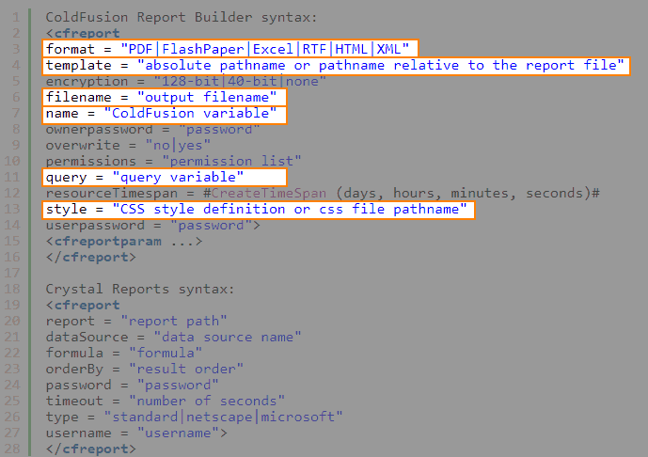
cfreport
<cfreport>
  Uses .cfr template with data
Additional feature tag
  <cfreportparam>
  Pass input parameters, override query data
  in subreports and charts, override styles
https://helpx.adobe.com/coldfusion/cfml-reference/coldfusion-tags/tags-r-s/cfreport.html

Slide 32
using cfreport
I let the database do the work wherever
it is appropriate…
<cfset template = expandPath("/templates/Avery5162.cfr")>
<cfquery name="qLabels" datasource="training">
SELECT Firstname, Lastname,
CASE
WHEN Address2 IS NULL THEN Address1
WHEN datalength(Address2) = 0 THEN Address1
ELSE Address1 + CHAR(13)+CHAR(10) + Address2
END AS Address,
City, State_Prov, ZIP_Postal
FROM Addresses ORDER BY Lastname, Firstname
</cfquery>
<cftry>
<cfreport format="PDF" template="#template#" query="qLabels" name="labels" />
<cfheader name="Content-Disposition" value="attachment;filename=Avery5162.pdf">
<cfcontent type="application/pdf" variable="#labels#">
<cfcatch>
<cfdump var="#cfcatch#">
</cfcatch>
</cftry>

Slide 33
cfreport in a cfc function
/**
* @displayname Publish Report
* @description Given path to cfreport, recordset and output path, publishes PDF report
* @hint .cfr path and output path are URLs from server root
* @output false
* @returnFormat json
* @secureJSON yes
* @verifyClient yes
*/
public string function publishReport( required string templatePath, required query recordSet, required string outputPath, required string filename )
{
var result = "Must specify templatPath (path of .cfr file), a valid recordset, outputPath (path to PDF file) and filename for report PDF.";
try {
templatePath = expandPath(arguments.templatePath);
outputPath = expandPath(arguments.outputPath);
if( right(outputPath, 1) != '\' ) {
outputPath &= '\';
}
outputPath &= arguments.filename;
cfreport( format="PDF", template="#templatePath#", query="recordSet", filename="#outputPath#", overwrite="yes" );
result = outputPath;
}
catch (any excpt) {
result = excpt;
}
return serializeJSON(result);
}

Slide 34
practical considerations
Good use for anything with repetitive, small elements
  Name tags
  Tickets
  Asset tags for IT items managed in CMDB
Best to create a CFC that takes template and query as arguments
  You can use same dataset with multiple files
  (I printed item labels with just names, and shipping labels)
Don’t persist the PDF, only the data

Slide 35
cfreport example
Quick demo:
  Log into http://training.latreia.com as cfug / seattle
  My courses > Fun with PDF
  Click ‘eyecon’ on cfreport to expand the topic
  Click demo of cfreport.
Click button ‘Generate Labels!’

Slide 36
cfpdf
Manipulating existing PDFs

Slide 37
cfpdf
Believe it or not, I have had occasion to do almost all these and more, for both corporate customers and Defense contract work.
Use cases
  Merge documents into single PDF
  Apply/remove header/footer
  Apply password/encryption
  Apply/remove watermark
  Output to file system
  Create thumbnails
  Extract text or images

Slide 38
cfpdf
The code examples for CFPDF take up more lines of code than the crew compliment of NCC-1701 (431).
Check out the documentation here:
https://helpx.adobe.com/coldfusion/cfml-reference/coldfusion-tags/tags-p-q/cfpdf.html
<cfpdf>
  The ‘Swiss Army knife’
  of PDF manipulation
  Used for manipulating existing PDF files, rather than building them
  Many options, some totally bizarre
  (watermarks, redaction, etc.)
Additional feature tag
  <cfpdfparam>
  Passes parameters for merge operations

Slide 39
cfpdf process ddx
One of the more useful and bizarre features:
Dynamic Document Exchange
  Subset of the XML used in Adobe LiveCycle® Enterprise Suite
  Bizarre: Proprietary (AKA non-standard) XML format
  Useful: Assemble multiple PDF documents into a book
    Headers and footers
    Cover
    Table of contents
    Section breaks, etc.

Slide 40
DDX
<DDX xmlns="http://ns.adobe.com/DDX/1.0/"
xmlns:xsi="http://www.w3.org/2001/XMLSchema-instance"
xsi:schemaLocation="http://ns.adobe.com/DDX/1.0/ coldfusion_ddx.xsd">
<PDF result="Out1">
<PDF source="Doc1"/>
<PDF source="Doc2"/>
</PDF>
</DDX>
Basic code looks deceptively simple:
  XML namespace
  PDF result location (“Out1”)
  A couple documents
Can add many features in the DDX
But…
  The DDX file is processed top to
  bottom, so necessary to add items
  in sequence… except styles
  DDX is case-sensitive
Note the space!
https://www.adobe.com/devnet/coldfusion/articles/ddx_pdf.html

Slide 41
cfpdf process ddx
<!--- confirm DDX is valid. --->
<cfif IsDDX("makeBook.ddx")>
<!--- Create a structure for the input files. --->
<cfset inputStruct=StructNew()>
<cfset inputStruct.Title="Title.pdf">
<cfset inputStruct.Doc1="Chap1.pdf">
<cfset inputStruct.Doc2="Chap2.pdf">
<!--- Create a structure for the output file. --->
<cfset outputStruct=StructNew()>
<cfset outputStruct.Out1="Book.pdf">
<!--- Process DDX to generates the book. --->
<cfpdf action="processddx" ddxfile="makeBook.ddx"
inputfiles="#inputStruct#"
outputfiles="#outputStruct#"
name="myBook">
</cfif>
General process:
  Generate or assemble PDF docs
  (if they are going into a TOC,
  be sure to set bookmarks)
  Create the DDX file with
  the docs listed in order
  Validate the DDX file
  Add the docs to an inputStruct
  Define the destination in
  an outputStruct
  Use CFPDF to process the DDX
  Pat yourself on the head if it works.

Slide 42
cfpdf process ddx
<!--- List installed fonts --->
<cfset adminObj = createObject("Component",
"cfide.adminapi.administrator")>
<!--- change to use your CF Admin password --->
<cfset adminObj.login("yourpass")>
<cfset rtService = createObject("component",
"cfide.adminapi.runtime")>
<cfset fonts = rtService.getFonts()>
<cfdump var="#fonts#">
Another thing to remember:
You can only use fonts installed
on the server for text that is
rendered by means of ddx.
  (Headers, footers, etc.)
Courtesy of Tim Cunningham, https://gist.github.com/timcunningham/3794186

Slide 43
DDX
Before attempting to do DDX, read Adobe online docs!
  https://helpx.adobe.com/coldfusion/cfml-reference/coldfusion-tags/tags-p-q/cfpdf.html
  https://helpx.adobe.com/coldfusion/developing-applications/working-with-documents-charts-and-reports/assembling-pdf-documents/using-ddx-to-perform-advanced-tasks.html

Slide 44
cfpdf example
Quick demo:
  Log into http://training.latreia.com as cfug / seattle
  My courses > Fun with PDF
  Click ‘eyecon’ on cfpdf to expand the topic
  Click on demo of cfpdf.
Enter your name
Click button ‘Build the brochure!’

Slide 45
cfpdfform
Data into and out of PDF forms

Slide 46
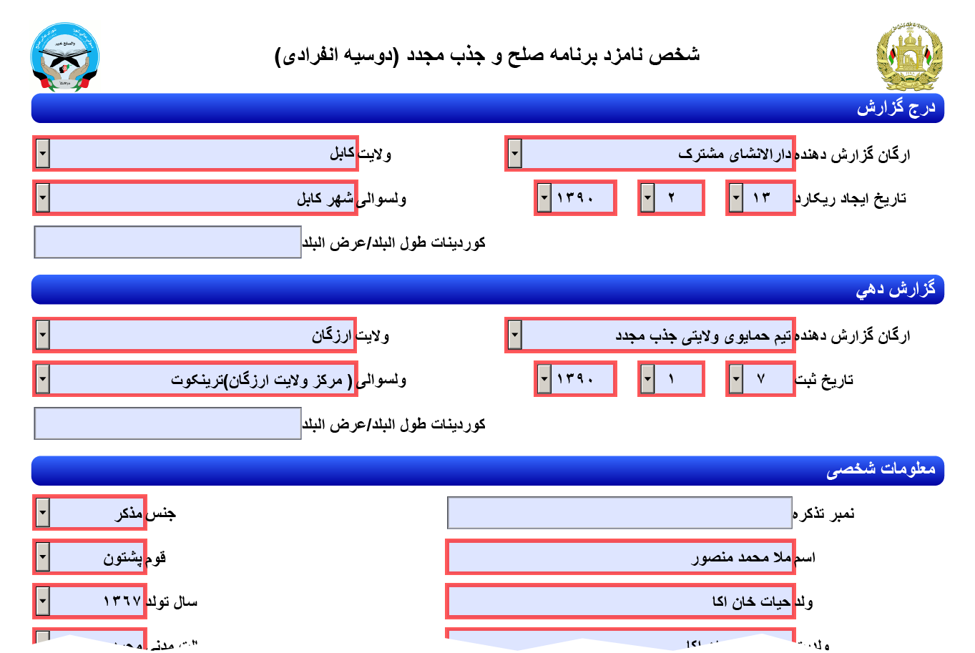
cfpdfform
PDF forms can be a great way
to capture data offline
  Ingest data online
Forms are ubiquitous
Many applications, from HR
forms to surveys
Portion of GIROA PDF – Reintegration / Government ID Card Application
(individual from a village in Shahidi Hassas district of Uruzgan Province)

Slide 47
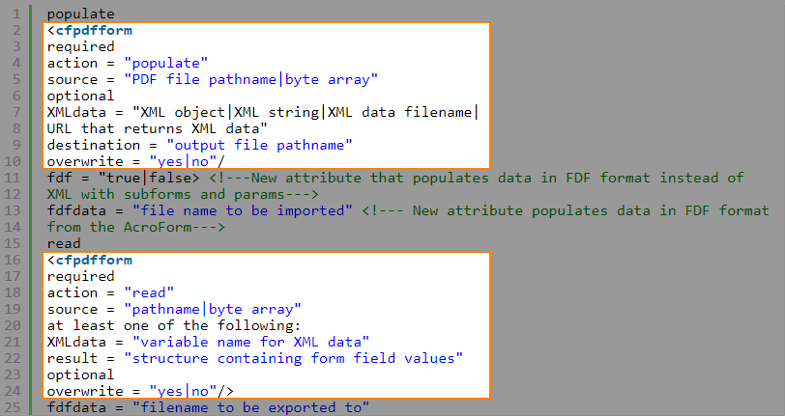
cfpdfform
Populate fields on PDF forms
Read data from PDF forms
  XFA or FDF
  Store in CF struct or file
<cfpdfformparam>
(for filling out forms, maps
PDF form field to CF variable)

Slide 48

cfpdfform
Sadly, not in Lucee
Ortus has an extension
  Pricey but if you need it…
  https://www.ortussolutions.com/products/ortuspdf

Slide 49
Using cfpdfform
<cfpdfform source="#demoFile#" result="resultStruct" action="read"/>
<cfscript>
/* WHITE LIST: No matter what is in the form file, only use input elements we trust
Appearance, Comments, Content, Delivery, Examples, Interest, Presenter, Title
Only Title is required */
// String fields
if(structKeyExists(resultStruct, 'Title') && isValid("string", resultStruct.Title) ) {
Title = encodeForHTML(resultStruct.Title);
}
…etc…
</cfscript>
SECURITY ALERT:
PDF Form fields can contain anything, and conceivably could be used as an attack vector. Scrub all field values and compare to a whitelist before doing anything with the data.

Slide 50
cfpdfform example
Quick demo:
  Log into http://training.latreia.com as cfug / seattle
  My courses > Fun with PDF
  Click ‘eyecon’ on cfpdfform to expand the topic
  Click on demo of cfpdfform.
  Download form
  Fill out and save (open in Acrobat)
  Upload form
Click button ‘Ingest data!’

Slide 51
Questions?
Anyone?
Bueller?

Slide 52
thanks!
Training Portal – This was an experiment, so may not leave up indefinitely. Feel free to grab what you can.
  http://training.Latreia.com
Email me with questions any time
  jim@Latreia.com

Slide 53
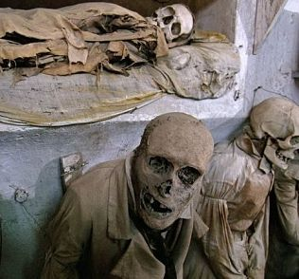
I think we’ve heard enough for tonight.
May we please go home?

Slide 54
Get Yoour Questions Answered. Ask the Group!
Got problem that you’re stuck on? Get advice with how to solve it from our user group.

Slide 55
Next Month’s Meeting
August 15, 2018 – WeWork – Lincoln Square
(if WeWork will have us back)
What would you like us to present on?

