Slide 1
Requirements Presentation
Dr. David Gilbert, D.Sc. CBAP
December 29, 2018

Slide 2

About the Presenter
Dr. David W. Gilbert, D.Sc.
Education:
Doctor of Science (D.Sc.) Information Systems and Communications; Robert Morris University
Masters of Science (MS) Information Systems Management; Seattle Pacific University
Masters Business Administration (MBA) Management; Seattle Pacific University
Bachelor of Science (BS) Marketing; Central Washington University
Certifications and Certificates:
Certified Business Analysis Professional (CBAP); International Institute of Business Analysis (IIBA)
Former Project Management Professional (PMP); Project Management Institute (PMI) Retired
Contact Points:
LinkedIn: https://www.linkedin.com/in/dr-david-gilbert-d-sc-pmp-cbap-ba659a7/
Facebook: https://www.facebook.com/david.w.gilbert.9

Slide 3
Purpose of Presentation
Introduction of Requirements/Design/Build as a Formal Engineering Process
Introduction of Team Roles within a large application design
Introduction of Design Features
Introduction of concept of design/build anywhere

Slide 4
Presentation Contents
Requirements Design Build Process
Requirements Design Build Team
Design Features
Requirements Definitions
Stakeholder Requirements
Use Cases, DFD
Wireframes
Design Package
Summary

Slide 5
Requirements/Design/Build Process:
[2]
[1]
[3]
[4]
[5]
[6]
[1] Current Architectural Configuration
[2] Change - Change Document
[3] Requirements - Requirements Document
[4] Design – Design Documents
[5] Build/Test/Implement – Hardware/Software/Processes
[6] New Architectural Configuration

Slide 6
Architectural Configuration
Architecture
  Business
  Information
  Application
  Data
  Technology/Infrastructure

Slide 7
Change – Problem/Solution Selection
Failure of alignment will result in symptoms of a problem.
Problem needs to be identified
Solution Options Presented
Solution Selected

Slide 8
Change – Solution Requirements
Input: Change Document with Authorization – Project Begins
Requirements development process
Output: Approved requirements document

Slide 9
Change – Solution Design
Input: Requirements Document
Design Process
Output: Design Documents

Slide 10
Change – Build, Test, Implement
Input: Design Documents
Build/Test/Implement
New Architectural Configuration

Slide 11
Design Build Team
Management Team
  Customer
  Sponsor
  Supervising Manager
  Project Manager
Design Team
  End-Users (Primary, Secondary)
  Business Analyst
  Architectural Team
    Business Architect
    Hardware Architect
    Information Architect
    Systems/Application Architect
      Designer
      Application Architect (Developer)
      Systems Architect
Build Team
  Developers
    Application Developer
    Application Programmer
    Multi-Media Developer
  Database Administrator
  Documentation Focal
  Hardware Focal
  Test/Implementation Focal

Slide 12
Design of Features
Must Haves: Basic features needed for the user
Should Haves: Additional features that increases application usefulness wanted by the user
Could Haves: Additional features that increase application usefulness of the application not requested by the user

Slide 13
Requirements Definitions:
Requirement Definitions (IIBA v2):
  1. A condition or capability needed by a stakeholder to solve a problem or achieve an objective.
  2. A condition or capability that must be met or possessed by a solution or solution
  3. A documented representation of a condition or capability as in (1) or (2)
Business Requirements (IIBA v3): Statements of goals, objectives, and outcomes that describe why a change has been initiated. They can apply to the whole of an enterprise, a business area, or a specific initiative.
Stakeholder Requirements (IIBA v3): Describes the needs of stakeholders that must be met in order to achieve the business requirements. They may serve as a bridge between business and solution requirements.
Solution Requirements (IIBA v3): Describes the capabilities and qualities of a solution that meets the stakeholder requirements. They provide the appropriate level of detail to allow for the development and implementation of the solution.
  Functional Requirements: Describe the capabilities that a solution must have in terms of the behaviour and information that the solution will manage.
  Non-Functional Requirements: Describe conditions under which a solution must remain effective or qualities that a solution must have.
Design Specifications: Design Specification is usually a design document that describes all data, architectural, interface and component-level design for the software. A design specification provides explicit information about the requirements for a product and how the product is to be put together.
Transition Requirements (IIBA v3): describe the capabilities that the solution must have and the conditions the solution must meet to facilitate transition from the current state to the future state, but which are not needed once the change is complete. They are differentiated from other requirements types because they are of a temporary nature. Transition requirements address topics such as data conversion, training, and business continuity.

Slide 14
Business Requirements:
ACME Nacelles: Design and builds custom warp nacelles
ACME Computing: Internal organization that design and builds custom computing systems for ACME Nacelles.
ACME User Validation & Test: Conducts User Testing on internally built computing systems for ACME Computing.
Organization | Business Need | Business Want
ACME Computing and Divisional Functional Executive Management | Executive Management needs the capability to ensure that both new, updated, and/or existing computing application functionality and associated process documentation meet ACME Computing standards for delivery to ACME Warp Nacelle programs. | Executive Management wants a tool that tests and reports that both new, updated, and/or existing application functionality and/or process documentation meet ACME Computing standards for delivery to ACME Warp Nacelle Programs for lower Functional/Domain organizations for which ACME Computing has both responsibility and authority to manage and regulate.
ACME User Validation & Test Management | ACME User Validation & Test Management the capability to facilitate, measure, and report UV&T testing for new, updated, and/or existing application functionality and/or process documentation for the benefit of ACME Computing and ACME Warp Nacelle Functional Organizations | ACME User Validation & Test Management wants a tool that prepares for testing, schedules test scripts, executes test scripts, and reports testing status for new, updated, and/or existing application functionality and/or process documentation meet ACME Computing standards for delivery to ACME Warp Nacelle Programs for delivery for their specific area, discipline, organization, product, or service.

Slide 15
Stakeholder Requirements:

Slide 16
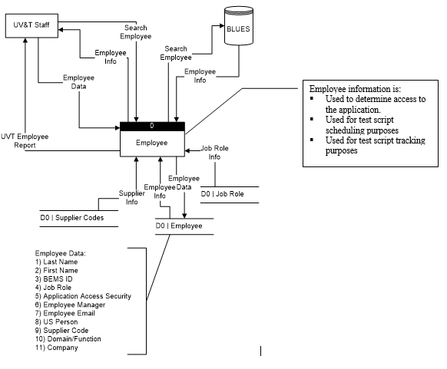
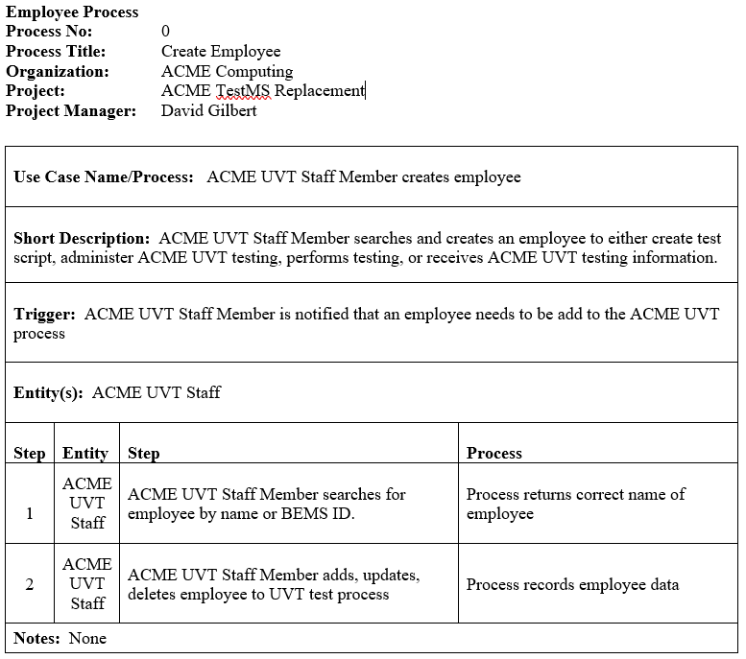
Requirements: DFD, Use Case

Slide 17
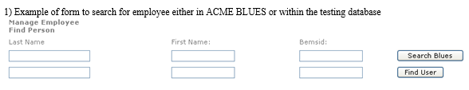
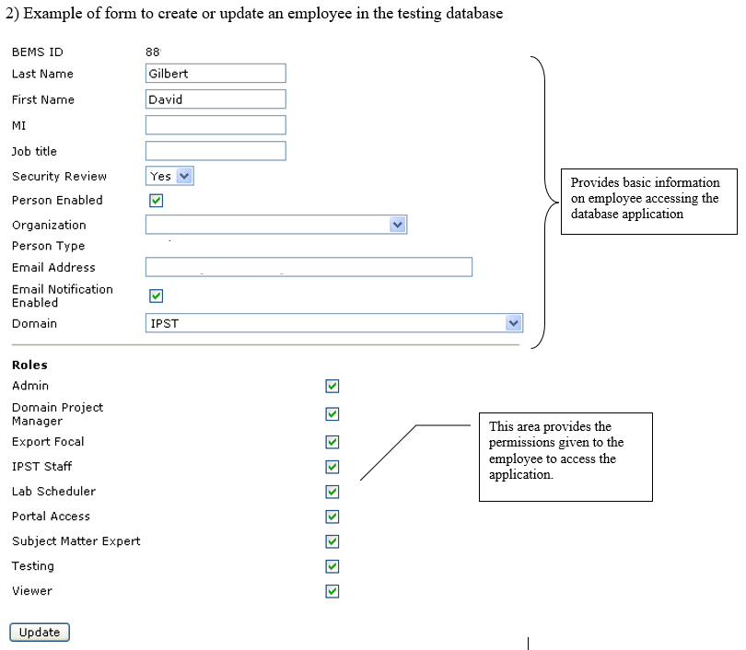
Requirements: Wireframes
Design wireframe drawings based on Stakeholder Requirements, DFD, and Use Case information

Slide 18
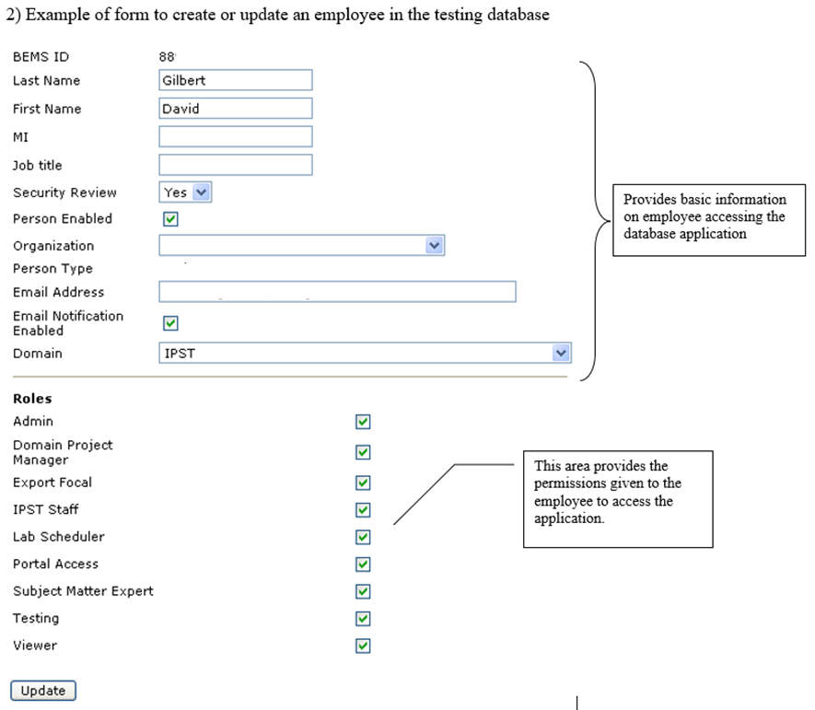

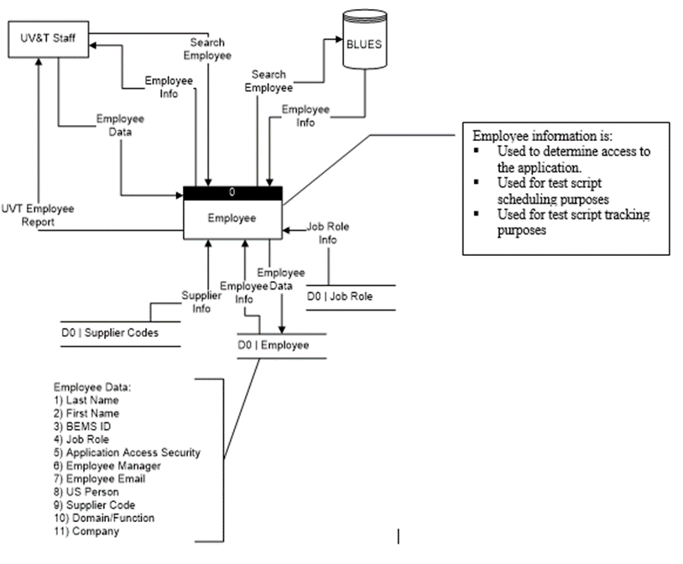
Requirements for Employee Data Update

Slide 19
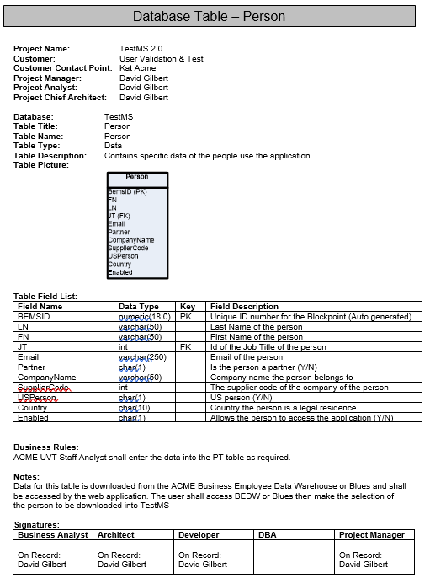
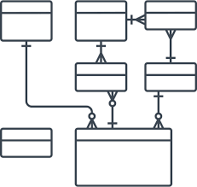
Design Package
Create Employee Data Update design package per approved requirements. Similar to: ______________
  Database Design
  Architectural Design
  Navigational Design
  Business Layer Design (Views, Procedures, CFCs, Etc.)
  Presentation Layer Design

Slide 20
Summary
What we have discussed:
  Requirements Design Build Process
  Design Build Team
  Requirements
    Business Requirements
    Stakeholder Requirements
    DFD, Use Cases
    Wireframes
  Design Package

Slide 21
References:
Database Design for Mere Mortals : A Hands-On Guide to Relational Database Design / Edition 1
  ISBN-10: 0201694719
  ISBN-13: 9780201694710

