Slide 1

August 2017

Slide 2
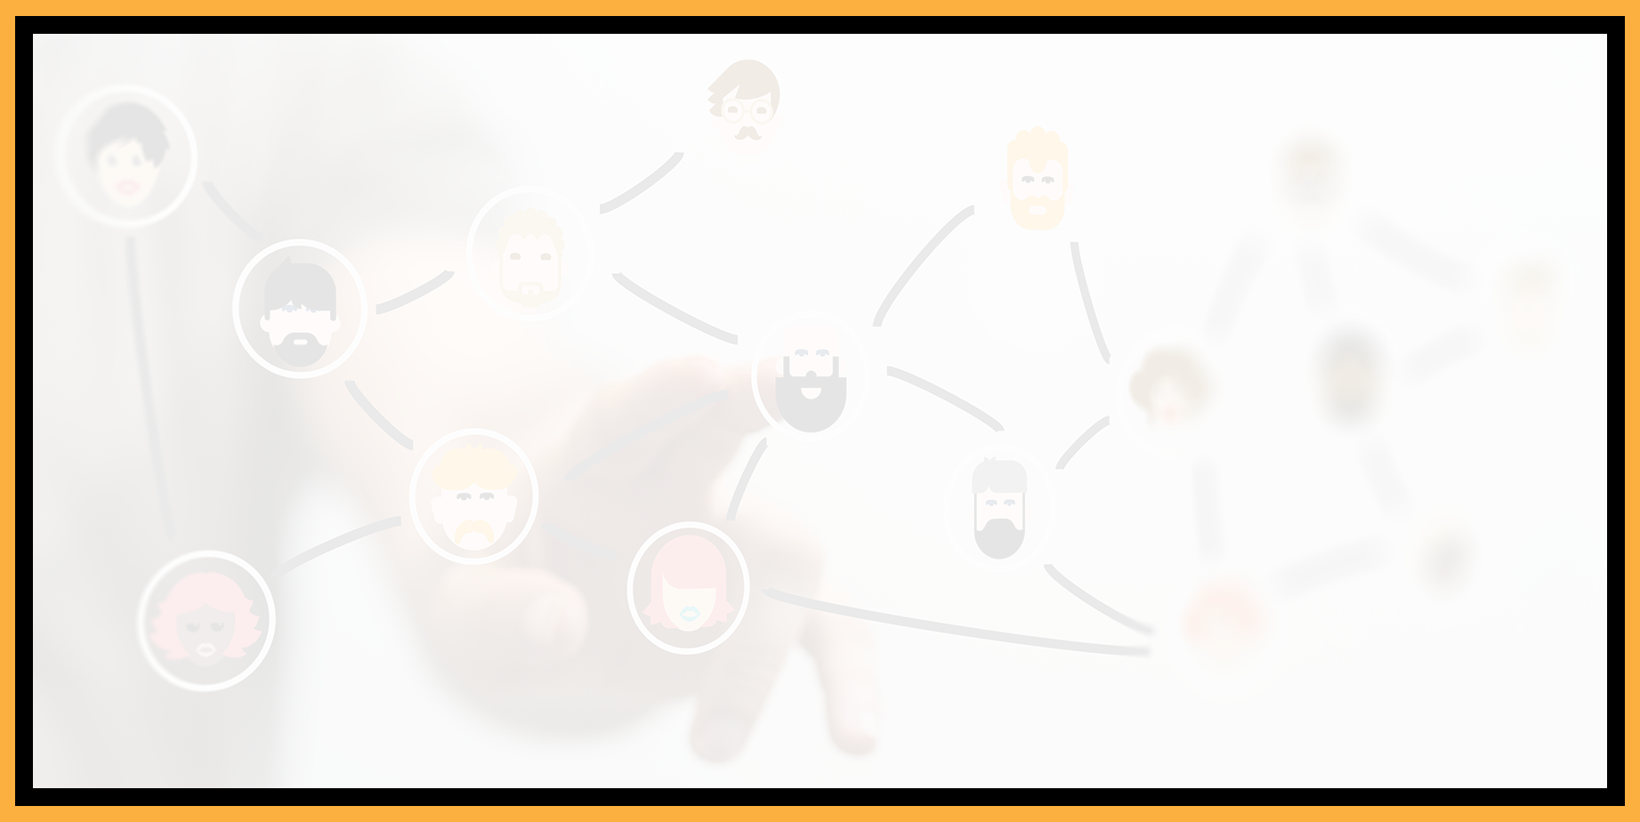
Agenda
Welcome to the Seattle ColdFusion User Group
Introductions
Goals
Adobe ColdFusion Developer Week
ColdFusion Frameworks
ColdFusion Resources & Upcoming Events
Social Media/On-line Resources
Web Site Coming Soon
Volunteer Opportunities
Next Month’s Meeting

Slide 3
Introductions
Tell us a little bit about who you are
Share with us what you would like to get from this user group

Slide 4
Goals
Assist ColdFusion Developers Throughout the
Pacific Northwest
Promote ColdFusion Developers Throughout the
Pacific Northwest
Connect Employers with ColdFusion Developers
Establish a Community of Friendship Between ColdFusion Developers
Provide Speaking Opportunities for ColdFusion Developers
Change the Perception of ColdFusion as a viable platform

Slide 5
ColdFusion Developer Week
ColdFusion Developer Week was held last week from
July 31st – August 4th
Big Takeways
  Adobe seems very committed to ColdFusion and is putting increased effort and resources into it
  Developers were encouraged to put more ColdFusion projects into GitHub, especially public ones that can be shared
  Adobe has heard our concerns about the Security Analyzer being tied to a CF Enterprise Server and is working on an option to provide that functionality to all developers

Slide 6
ColdFusion Developer Week
Videos to be posted soon for all of the following topics
  The now and the next of Adobe ColdFusion
  API Economy: Realizing The Business Value of APIs Through Adobe API Management
  Design of REST API and REST in ColdFusion
  Upgrade to ColdFusion 2016
  Finding security vulnerabilities in your code base using security analyzer
  Load Balancing, Scalability and Failover with ColdFusion Clustering
  PDF enhancements in ColdFusion 2016
  Language enhancements in ColdFusion 2016
  Scale with ColdFusion 2016

Slide 7
ColdFusion Developer Week
William Frankhouser from WilzDesign and Everett Community College attended 5 of the sessions (thank you William)
The Now and the Next of ColdFusion
  Transformation Since 2010
    CF10 (2010) was HTML5 + REST
    CF 11 (2012) was + Mobility
    CF 2016 + API Management; security analyzer
      High performance .. 30% faster; session storage on distributed cache
      Security… scan code for OWASP top 10; secure by default
      Productivity… CLI, PDF, Language functions, operators, datatypes
      API Manager

Slide 8
ColdFusion Developer Week
CF 2018 + Microservices (Containerized platform, Async programming, automated lockdown, Performance Management Suite)
  Docker, Red Hat Openshift Container Platform
  CF 2018 will be supported till 2025
CF 2020 Requirements are being formulated

Slide 9
ColdFusion Developer Week
Security
  Adobe Secure Product Lifecycle (SPLC)
    Focus on embedding security into product requirements and planning
    Adobe has been using SD Elements since 2014 to assist https://www.securitycompass.com/sdelements/
    More Info: https://blogs.adobe.com/security/tag/secure-product-lifecycle
  No ZERO-Day Vulnerabilities since 2012
  Ability to Run ColdFusion 2016’s Security Code Analyzer from the Command Line using code created by David Epler: https://github.com/dcepler/cf-cmdline-sec-ana

Slide 10
ColdFusion Developer Week
Test Your ColdFusion Code Using Online Services
  CFLive.net (powered by Lucee): http://cflive.net
  TryCF.com: https://trycf.com/
GitHub Repos Growth:
1800 in 2012 to almost 14,000 in 2016

Slide 11
ColdFusion Developer Week
Test Your ColdFusion Code Using Online Services
  CFLive.net (powered by Lucee): http://cflive.net
  TryCF.com: https://trycf.com/
GitHub Repos Growth:
1800 in 2012 to almost 14,000 in 2016

Slide 12
ColdFusion Frameworks
Frameworks throughout the ages
  Fusebox
    Originally created in 1997 and now open-sourced
    Has versions for ASP and PHP
    Uses Fuseactions
    Web Site: http://fusebox.org/
    Latest Version: 5.5.2 (there is a listing for 5.6 on the site, but it doesn’t appear to be available from GitHub). Last commit on GitHub for 5.5.2 was on
    May 10, 2012

Slide 13
ColdFusion Frameworks
Frameworks throughout the ages
  Mach-II
    Very Popular Object-Oriented MVC Framework
    All actions in a Mach-II application are event announcements, so there is no concept in a Mach-II application of linking to a specific CFML file.
    Events are announced, either in the URL or programmatically, and this subsequently kicks off a series of developer-defined actions for that event, such as data processing or gathering data and displaying it to the user.
    Web Site: http://mach-ii.com/
    GitHub Repo: https://github.com/Mach-II/Mach-II-Framework
    Sunsetted in 2013

Slide 14
ColdFusion Frameworks
Frameworks throughout the ages
  FW/1 (Framework 1)
    Actively maintained by Sean Corfield
    Supported from ACF 9.0 on, however latest version of FW/1 required ACF 10.0 and greater or Lucee 4.5 and greater
    Lightweight MVC Framework that supports dependency injection (passing of a dependency to a dependent object) and aspect-oriented programming (programming paradigm that aims to increase modularity by allowing the separation of cross-cutting concerns).
    FW/1 Blog: http://framework-one.github.io/
    FW/1 Documentation: http://framework-one.github.io/documentation/4.1/
    GitHub Repo: https://github.com/framework-one/fw1
    Fun Fact - Sean Corfield was involved with Fusebox 5 and 5.1 from 2006-2008)

Slide 15
ColdFusion Resources
Training
  Lynda.com (free for King Country Library Members). 4 courses available:
    Via King County Library: https://kcls.org/resources-types/courses-training/
    Direct: https://www.lynda.com/ColdFusion-training-tutorials/174-0.html
  Getting Started with Adobe ColdFusion 2016: https://www.adobeknowhow.com/courselanding/getting-started-coldfusion-2016 (SSL Certificate expired on 8/5/2017)
  Learn CF in a Week: http://learncfinaweek.com/

Slide 16
ColdFusion Resources
Programming/Language Resources
  Adobe ColdFusion Developer Center: http://www.adobe.com/devnet/coldfusion.html
  ColdFusion Help: https://helpx.adobe.com/coldfusion/home.html
  CFLib.org (Common Functions Library):
  http://cflib.org/
  BenNadel.com (Lots of tips and code references/examples):
  https://www.bennadel.com/
  CFDocs (Tags and functions reference): https://cfdocs.org/
  Charlie Arehart’s site (videos, training, links): http://www.carehart.org/

Slide 17
Upcoming Events
NCDevCon (http://ncdevcon.com) – October 7-8 – Raleigh, NC
Adobe ColdFusion Summit
  Dates: November 16-17 (pre-conference workshops on the 15th)
  Location: The Mirage Resorrt and Casino – Las Vegas, NV
  More Info and Registration: https://cfsummit.adobeevents.com/

Slide 18
Seattle CFUG Social Media
Facebook: https://www.facebook.com/seattlecoldfusionusergroup/
Twitter: https://twitter.com/seattlecfug @seattlecfug
Meetup (join our group here): https://www.meetup.com/Seattle-ColdFusion-User-Group/
EventBrite (register for our events here)

Slide 19
Web Site Coming Soon
seattlecfug.org
Fully Responsive
Social Resource Link
Member bios/photos/links (active members)
Events
Contact
Directions
About ColdFusion
ColdFusion Resources

Slide 20
Volunteer Opportunities
Social Media
Web Site
Presentations

Slide 21
Next Month’s Meeting
September 12, 2017 – OnlineMetals.com

