Slide 1

April 2018

Slide 2
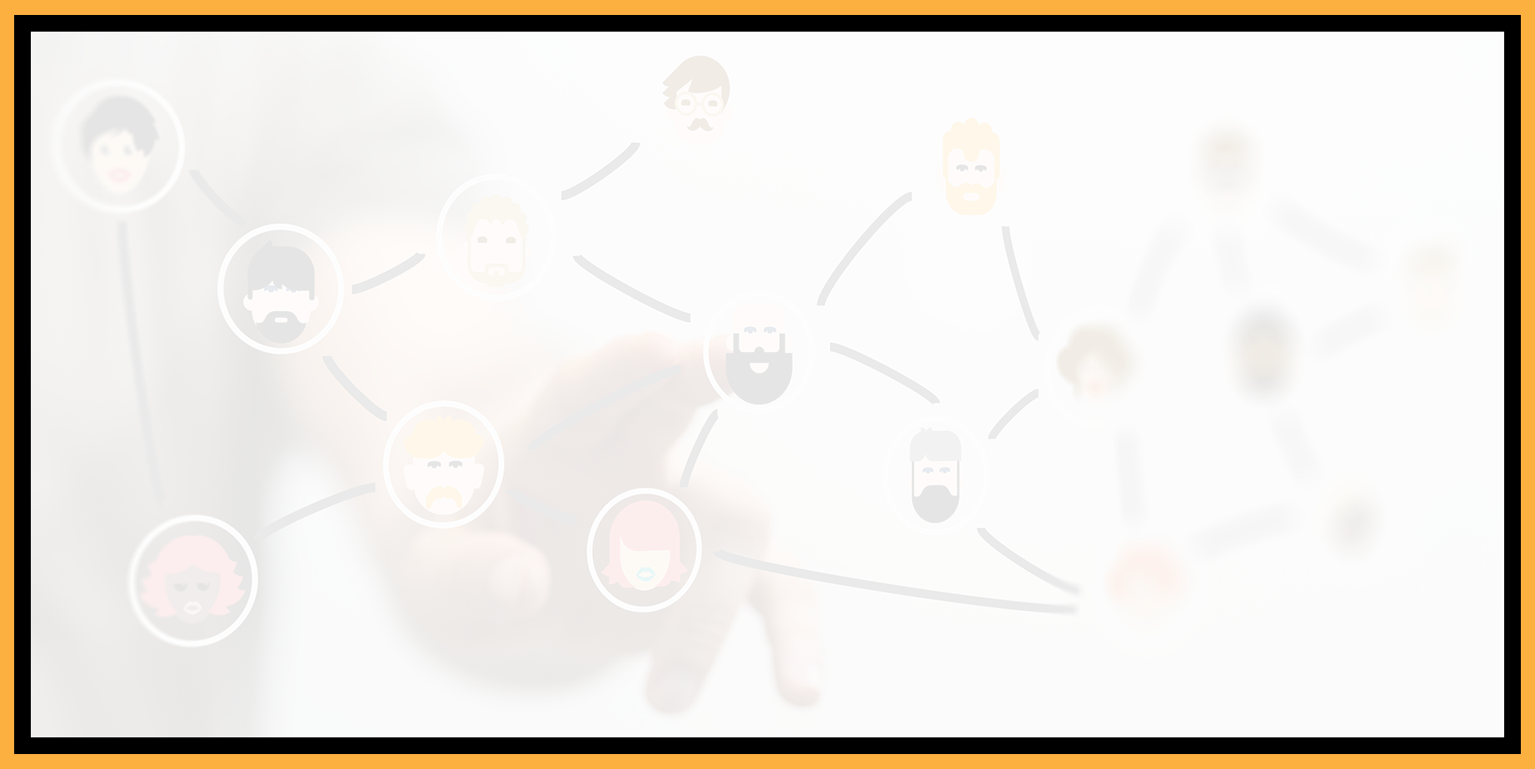
Agenda
Welcome to the Seattle ColdFusion User Group
Introductions
Goals
CI/CD for ColdFusion with Slack
How to protect your web application from click-jacking
Why SALTing your passwords is a GOOD thing
Upcoming ColdFusion Events
Next Steps for the Seattle ColdFusion User Group

Slide 3
Introductions
Tell us a little bit about who you are
Share with us what you would like to get from this user group

Slide 4
Goals
Assist ColdFusion Developers Throughout the
Pacific Northwest
Promote ColdFusion Developers Throughout the
Pacific Northwest
Connect Employers with ColdFusion Developers
Establish a Community of Friendship Between ColdFusion Developers
Provide Speaking Opportunities for ColdFusion Developers
Change the Perception of ColdFusion as a viable platform

Slide 5
CI/CD for ColdFusion with Slack
Chris Straight – Lead Web Application Developer
Online Metals

Slide 6
How to protect your web application from clickjacking
What is Clickjacking?
Clickjacking is an exploit that fools a web site user to interact with a site for the purposes of the attacker.
Typically, the attacker will:
  Have done extensive research on the particular web site to exploit
  Determine which functionality on the site to exploit (for example, a person’s bank account), and include that content as an iFrame on their web site
  Take advantage of the logged-in user to have them perform actions on the web site to their benefit (examples of exploits involved transferring money to the attacker’s account, to pad Facebook Likes for an individual (among many others)

Slide 7
How to protect your web application from clickjacking
X-WebKit-CSP
How Do I Protect My App Against This?
Do not allow your web site to be included within an iFrame by an attacker.

Slide 8
How to protect your web application from clickjacking
X-WebKit-CSP
What Are the Protections I can Add?
There are several things that you should include to provide the widest protection for users of older to the most modern web browsers
Add the following CFHEADER tags to your Application.cfm or Application.cfc
<cfheader name=“Content-Security-Policy" value="frame-ancestors 'none'”>
<cfheader name=“X-Content-Security-Policy” value="frame-ancestors 'none'”>
<cfheader name=“ X-WebKit-CSP” value="frame-ancestors 'none’”>
- or –
<cfheader name=“Content-Security-Policy" value="frame-ancestors 'self'”>
<cfheader name=“X-Content-Security-Policy” value="frame-ancestors 'none'”>
<cfheader name=“ X-WebKit-CSP” value="frame-ancestors 'none’”>
more info: https://caniuse.com/#search=Content%20Security%20Policy%201.0

Slide 9
How to protect your web application from clickjacking
What Are the Protections I can Add?
Add the following CFHEADER tag to your Application.cfm or Application.cfc
<cfheader name="X-Frame-Options" value=“DENY">
- or -
<cfheader name="X-Frame-Options" value=“SAMEORIGIN">
This option fills the gap for many other browsers (but not all) that do not support the content-security-policy header
see: https://caniuse.com/#search=X-Frame-Options%20HTTP%20header

Slide 10
How to protect your web application from clickjacking
What Are the Protections I can Add?
Add a “Best-for-now Legacy Browser Frame Breaking Script”
In the document HEAD element, add the following:
<style id="antiClickjack">body{display:none !important;}</style>
And then delete that style by its ID immediately after in the script:
<script type="text/javascript">
if (self === top) {
var antiClickjack = document.getElementById("antiClickjack");
antiClickjack.parentNode.removeChild(antiClickjack);
} else {
top.location = self.location;
}
</script>

Slide 11
How to protect your web application from clickjacking
What Are the Protections I can Add?
If you would prefer, and you are using IIS, add the following code to your web.config file under <configuration><system.webServer><httpProtocol> <customHeaders>
<clear />
<add name="Content-Security-Policy" value="frame-ancestors 'self' X-Frame-Options: SAMEORIGIN;upgrade-insecure-requests" />
<add name="X-Content-Security-Policy" value="frame-ancestors 'none'" />
<add name="X-WebKit-CSP" value="frame-ancestors 'none'" />
Download example web.config

Slide 12
How to protect your web application from clickjacking
Example
Clickjacking Allowed: https://www.seattlecfug.org/presentations/clickjacking.cfm
Clickjacking Not Allowed: https://www.seattlecfug.org/presentations/clickjackingDisallowed.cfm

Slide 13
How to protect your web application from clickjacking
References
OWASP Clickjacking Defense Cheat Sheet:
https://www.owasp.org/index.php/Clickjacking_Defense_Cheat_Sheet
Can I Use? https://caniuse.com
Blackhat 2013 – Clickjacking Revisited - A Perceptual View of UI Security: https://www.youtube.com/watch?v=KUoHW3Eq-n4
Burp Suite Professional (will allow you to navigate to a page and write the script to test if a site is vulnerable to clickjacking) - https://portswigger.net/

Slide 14
Why SALTing Your Passwords is a Good Thing
Storing passwords in your database is NOT an ideal thing
Storing password unencrypted is an even worse thing
Passwords should be hashed using the SHA-512 algorithm to provide a good level of assurance that a user’s password cannot easily be compromised. This is accomplished using a SALT

Slide 15
Why SALTing Your Passwords is a Good Thing
What is a SALT (secret)…and why should I use one?
A SALT (in this context) is a string that is used to help encrypt/decrypt a password
The SALT would be created using the following function:
<cfset variables.salt = Hash(GenerateSecretKey("AES"), "SHA-512") />
The password would be hashed using the SALT as follows:
<cfif variables.hashedPassword = Hash(form.password & variables.salt, "SHA-512") />

Slide 16
Why SALTing Your Passwords is a Good Thing
How would I use the “hashed” password?
You would validate, on login, that the password provided in the form matches the hashed password as follows:
<cfquery name=“checkPwd” datasource=“#Application.myDataSource#”>
SELECT Email, Password
FROM User
WHERE Email = <cfqueryparam cfsqltype=“cf_sql_varchar” value=“#Form.Email#”>
</cfquery>
<cfif checkPwd.recordCount EQ 1>
<cfif checkPwd.Pwd EQ Hash(form.password & variables.salt, "SHA-512")>
<!--- Password is good – Woot --- Woot --- Log the person in --->
  <cfelse>
  <!--- Password is bad --->
  </cfif>
  <cfelse>
  <!--- No E-Mail Match --->
  </cfif>

Slide 17
Why SALTing Your Passwords is a Good Thing
References
David Epler – Learn CF in a Week – Secure Password Storage: http://www.learncfinaweek.com/week1/Secure_Password_Storage/
Generate Secret Key: https://helpx.adobe.com/coldfusion/cfml-reference/coldfusion-functions/functions-e-g/generatesecretkey.html or https://cfdocs.org/generatesecretkey
Hash: https://helpx.adobe.com/coldfusion/cfml-reference/coldfusion-functions/functions-h-im/hash.html or https://cfdocs.org/hash

Slide 18
Upcoming ColdFusion Events
Adobe ColdFusion Summit 2018
Hard Rock Hotel and Casino – Las Vegas
October 1st – 3rd
Register at https://cfsummit.adobeevents.com/register/
$99.00 registration is still available until April 30th

Slide 19
Next Steps for the Seattle ColdFusion User Group
Does this venue work for you, or would We Work in Bellevue work better?
What would you like our group to focus on?
What topics would you like to hear?

Slide 20
Volunteer Opportunities
Social Media
Web Site
Presentations

Slide 21
Next Month’s Meeting
May 9, 2018 – OnlineMetals.com

