Slide 1
June 2023

Slide 2
Agenda
Introductions
Adobe ColdFusion Summit 2023
How to gracefully handle errors in your application
CFML Function ‘O Day – Featuring IsValid()
Questions/Answers/Help Needed
Next Meeting

Slide 3
Introductions
Tell us a little bit about who you are

Slide 4
ColdFusion Summit 2023
Dates: October 2nd – October 4th
Location: The Mirage Hotel and Casino – Las Vegas, NV
Opportunity to become a Adobe Certified Professional: ColdFusion
Early Bird discounts available now though May 31st!
$99.00 for the Session Pass
$199.00 for the Professional Pass (includes access to ColdFusion Certification training on October 4th
Link: https://cfsummit.adobeevents.com/

Slide 5
How to gracefully handle errors in your application
Presenters:
Leon O’Daniel – Senior Web Application Developer – The Boeing Company
Will Frankhouser – Senior Web Application Developer – The Boeing Company

Slide 6
How to gracefully handle errors in your application
What we will cover
Gracefully handling missing pages in your application
Which order does ColdFusion handle server errors (exceptions)
Gracefully handling application-level exceptions
Handling Page-level exceptions using CFTRY (try)/CFCATCH (catch)
A working example – Calculating Washington State sales tax and making sure it returns tax info even if there is an error
XML Functions: IsXML(), XMLParse(), XMLSearch()
Getting Specific XML data values using XPath Queries
<CFError> - do you still like me – I have purpose too …

Slide 7
How to gracefully handle errors in your application
Gracefully Handling Missing Pages in your application
The onMissingTemplate method
This is a method that can be added to your Application.cfc file
Will do all sorts of things when it finds a missing CFM file
Typical use is to redirect to a 404 page
Example: https://www.odanieldesigns.com/ilovemissingpages.cfm
Where does this approach fall flat?

Slide 8
How to gracefully handle errors in your application
Gracefully Handling Missing Pages in your application
Configuring 404 Error Handling at the Server Level
This approach will cover all missing pages (and folders)
Microsoft Windows: Setup Error Handling using a web.config file <?xml version="1.0" encoding="UTF-8"?>
<configuration>
<system.webServer>
<httpErrors errorMode="DetailedLocalOnly">
<remove statusCode="404" subStatusCode="-1" />
<error statusCode="404" subStatusCode="-1" prefixLanguageFilePath="" path="/404.cfm" responseMode="ExecuteURL" />
</httpErrors>
</system.webServer>
</configuration>

Slide 9
How to gracefully handle errors in your application
ErrorDocument 404 /error404.html
Gracefully Handling Missing Pages in your application
Configuring 404 Error Handling at the Server Level
This approach will cover all missing pages (and folders)
Apache: Use the ErrorDocuments directive
If you are using a Virtual host file, add the following inside VirtualHost tag
<VirtualHost>
...
ErrorDocument 404 /error404.html
...
</VirtualHost>

Slide 10
How to gracefully handle errors in your application
ErrorDocument 404 /error404.html
Which Order Does ColdFusion Handle Exceptions?
Page-level error handling – CFTRY (try)/CFCATCH (catch) – Example of tag and script
Think very specific to the logic in place, what functions or connections it is trying to call
View the interruption from the end-user point of view. Is it an abrasive STOP or gentle message that allows them to continue on the web site.
What about <cfrethrow>?
Do I really need to use a <cffinally>?
Application-level error-handling (onError method in Application.cfc) <cffunction name="onError"> <cfargument name="exception" required="true"> <cfargument name="eventName" required="true">
<p><cfoutput>OnError – event: #arguments.eventName#</cfoutput></p> <cfdump var="#arguments.exception#" label="OnError: exception"> </cffunction>
Notes:
The onError() method in ColdFusion is a global error handler that is invoked when an exception occurs that was not caught by a cftry or cfcatch statement. The onError() method is defined in Application.cfc. You can use the onError() method as a filter to handle selected errors, and use other ColdFusion error-handling techniques for the remaining errors.

Slide 11
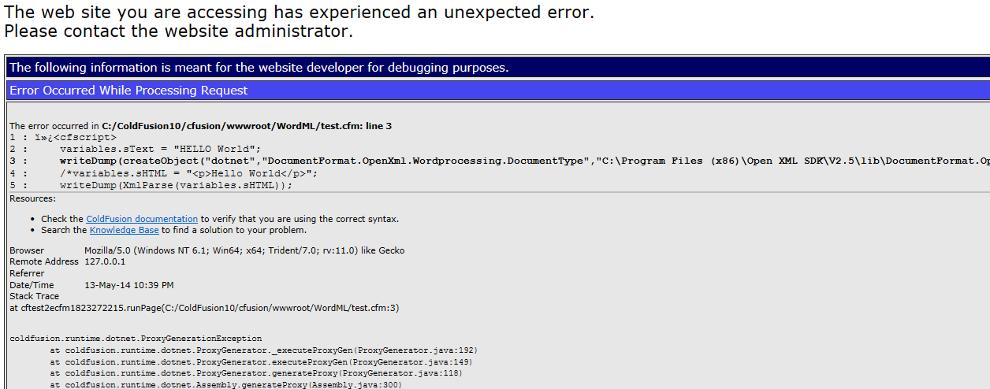
How to gracefully handle errors in your application
ErrorDocument 404 /error404.html
Which Order Does ColdFusion Handle Exceptions?
Site-wide error handler (really server-wide) and then if all else fails…
the ColdFusion Server Generic handler – Yucky – Bad!

Slide 12
How to gracefully handle errors in your application
ErrorDocument 404 /error404.html
Handling page-level exceptions in your application using CFTRY (try)/CFCATCH (catch)
Allows you to customize how your application responds to all sorts of errors (including custom errors) at the page level:
application: catches application exceptions
database: catches database exceptions
template: catches ColdFusion page exceptions
security: catches security exceptions
object: catches object exceptions
(continued on next screen)

Slide 13
How to gracefully handle errors in your application
ErrorDocument 404 /error404.html
Handling page-level exceptions in your application using CFTRY (try)/CFCATCH (catch)
Allows you to customize how your application responds to all sorts of errors (including custom errors) at the page level:
missingInclude: catches missing include file exceptions
expression: catches expression exceptions
lock: catches lock exceptions
custom_type: catches the specified custom exception type that is defined in a cfthrow tag
searchengine: catches Solr search engine exceptions
any: catches all exception types

Slide 14
How to gracefully handle errors in your application
ErrorDocument 404 /error404.html
A working example: the Washington State Tax Rate Service
Tag-Based Example
Script-Based Example (with X-Path demo)

Slide 15
How to gracefully handle errors in your application
ErrorDocument 404 /error404.html
A working example: the Washington State Tax Rate Service
Tag-Based Example
Script-Based Example (with X-Path demo)
Within a method of a ColdFusion Component (CFC)

Slide 16
How to gracefully handle errors in your application
ErrorDocument 404 /error404.html
A working example: the Washington State Tax Rate Service (XML functions)
isXML() – checks to see if the content within its parenthesis is valid XML or not – works with both XML Strings and XML Objects.
XMLParse() – converts XML strings to XML objects – makes it easier to use Xpath queries
XMLSearch() – enables using Xpath queries to search XML Objects

Slide 17
How to gracefully handle errors in your application
ErrorDocument 404 /error404.html
A working example: the Washington State Tax Rate Service (XPath Queries)
XmlSearch(VARIABLES.getParsedTaxInfo,"/response/rate[1]/@name")
XML Object variable
Root Element
1st child Element
name attribute

Slide 18
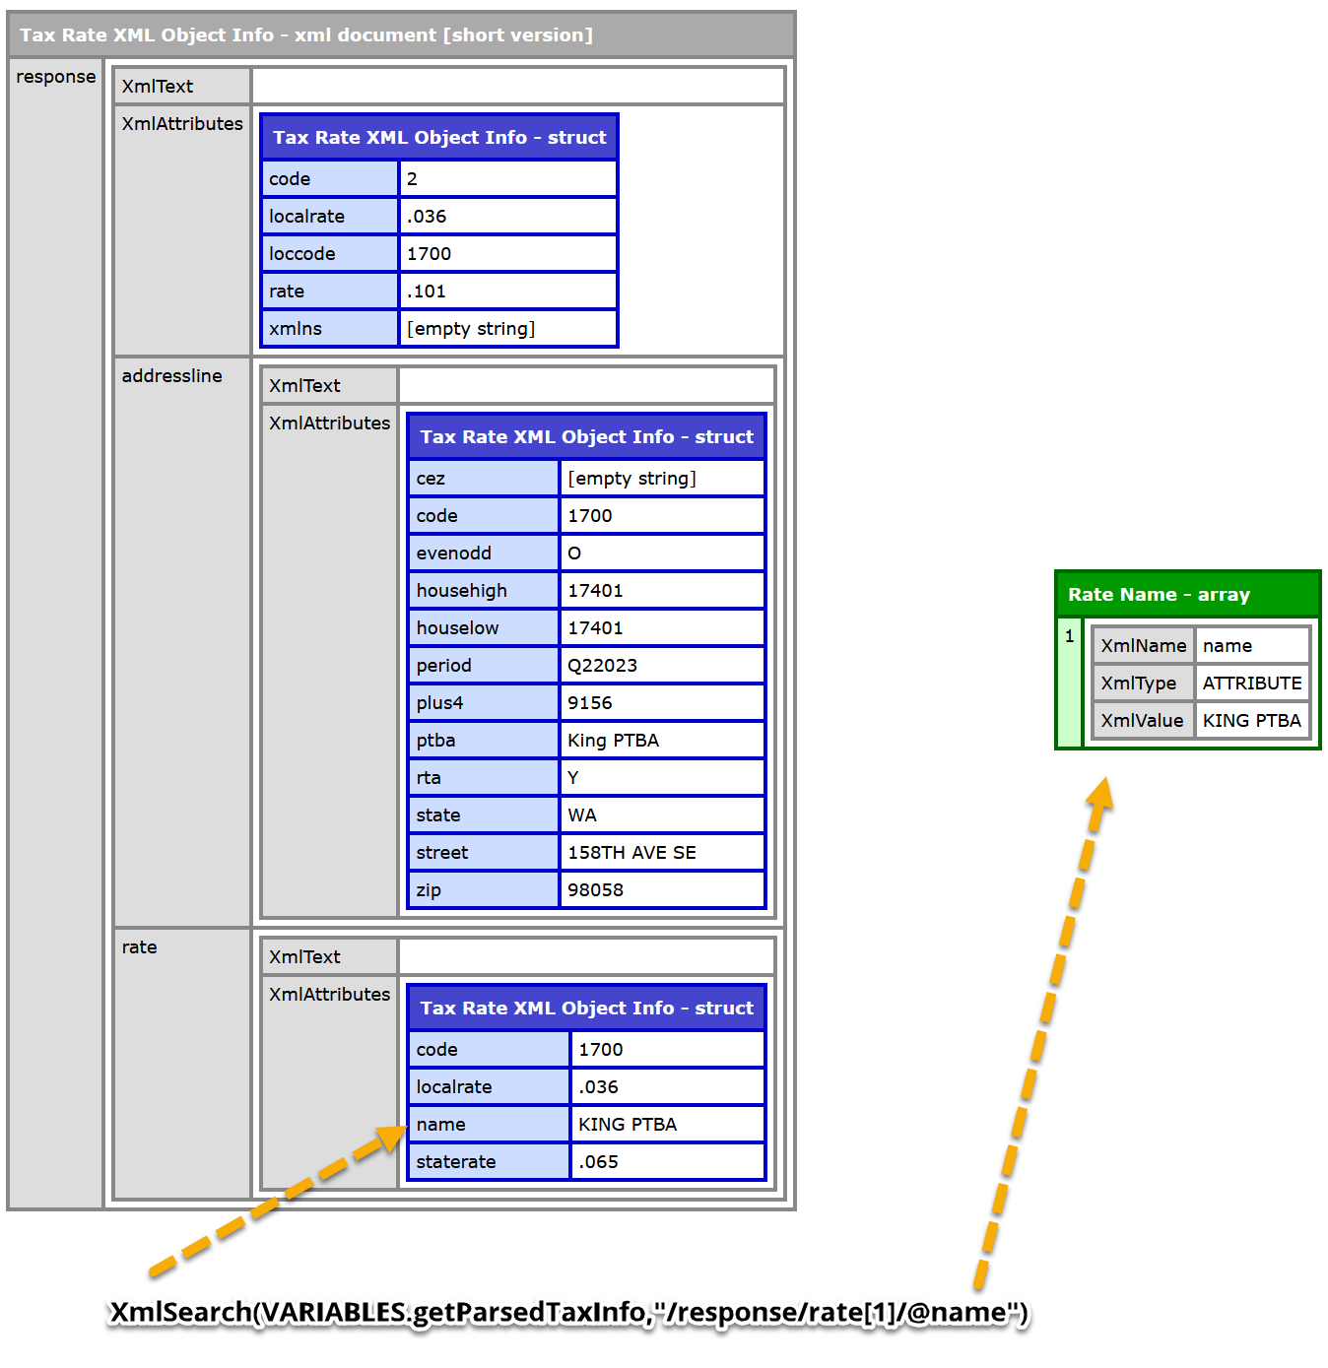
How to gracefully handle errors in your application
ErrorDocument 404 /error404.html
XmlSearch example
more info: https://www.w3schools.com/xml/xpath_syntax.asp

Slide 19
How to gracefully handle errors in your application
ErrorDocument 404 /error404.html
<CFError> - do you still like me – I have purpose too …
The <CFError> tag displays a custom HTML page when an error occurs. This lets you maintain a consistent look and feel among an application's functional and error pages.
<cferror
template = "template path"
type = "exception|validation|request"
exception = "exception type"
mailTo = "e-mail address">
More info: https://helpx.adobe.com/coldfusion/cfml-reference/coldfusion-tags/tags-d-e/cferror.html

Slide 20
CFML Function ‘O Day – Featuring IsValid()
ErrorDocument 404 /error404.html
presented by Will Frankhouser

Slide 21
Questions/Answers/ Help Needed
This is your opportunity to ask any ColdFusion question or request help for a ColdFusion-related issue.

Slide 22
Next Meeting
July 19, 2023 – 5:00 PM PDT (online via Zoom).
Tag or function O’ the day – Will Frankhouser
Topic TBD

