Slide 1
January 2019

Slide 2
Agenda
Welcome to the Seattle ColdFusion User Group
Goals
Introductions
Leveraging SQL Server Stored Procedures and Scalar Functions in Your ColdFusion App
The Importance of Proper Requirements Definition With Your Next ColdFusion Project
CSS Trick for Alternating Data Grid Row Colors

Slide 3
Agenda
February 2019 Seattle CFUG Meeting
Questions/Answers/Help Needed

Slide 4
Goals
Assist ColdFusion Developers Throughout the Pacific Northwest
Promote ColdFusion Developers Throughout the Pacific Northwest
Connect Employers with ColdFusion Developers
Establish a Community of Friendship Between ColdFusion Developers
Provide Speaking Opportunities for ColdFusion Developers
Change the Perception of ColdFusion as a viable platform

Slide 5
Introductions
Tell us a little bit about who you are
Share with us what you would like to get from this user group

Slide 6
Leveraging Microsoft SQL Server Stored Procedures and Scalar Functions in your CF App
What is a stored procedure and why should I use them?
How do I use stored procedures in my ColdFusion app?
What are scalar functions and why should I use them?
How do I use scalar functions in my ColdFusion app?

Slide 7
Leveraging Microsoft SQL Server Stored Procedures and Scalar Functions in your CF App
What is a stored procedure? A stored procedure is compiled tSQL code which can be efficiently reused
Why should I use stored procedures?
Code Reuse (we love code reuse)
Obfuscate database objects
Dynamic SQL Reduction

Slide 8
Leveraging Microsoft SQL Server Stored Procedures and Scalar Functions in your CF App
ColdFusion Tags for Stored Procedures
<cfprocedure> used to invoke a stored procedure https://cfdocs.org/cfstoredproc
<cfprocparam> used to pass parameters to/from stored procs https://cfdocs.org/cfprocparam
<cfprocresult> used to pass a recordset from a stored proc https://cfdocs.org/cfprocresult

Slide 9
Leveraging Microsoft SQL Server Stored Procedures and Scalar Functions in your CF App
<CFStoredProc> Example
<cfstoredproc datasource="#Application.RODSN#" procedure="getPointsEarnedByDateRangeAndLocation">
<cfprocparam cfsqltype="CF_SQL_DATE" value="#VARIABLES.StartDate#">
<cfprocparam cfsqltype="CF_SQL_DATE" value="#VARIABLES.EndDate#">
<cfprocparam cfsqltype="CF_SQL_TINYINT" value="#VARIABLES.LocationId#">
<cfprocresult resultset="1" name="VARIABLES.allData">
<cfprocresult resultset="2" name="VARIABLES.groupedData">
</cfstoredproc>

Slide 10
Leveraging Microsoft SQL Server Stored Procedures and Scalar Functions in your CF App
What are scalar functions? Scalar functions are those that take one or more values…but only return a single value (and not a recordset). Many scalar functions are built-in to SQL Server (examples: SUM, Count, MIN, MAX, RTRIM, LTRIM) More info: https://www.w3schools.com/sql/sql_ref_sqlserver.asp and https://docs.microsoft.com/en-us/sql/t-sql/functions/functions?view=sql-server-2017
When would I use scalar functions?
To simplify logic in a stored procedure?
To modify the value of a column returned from a query

Slide 11
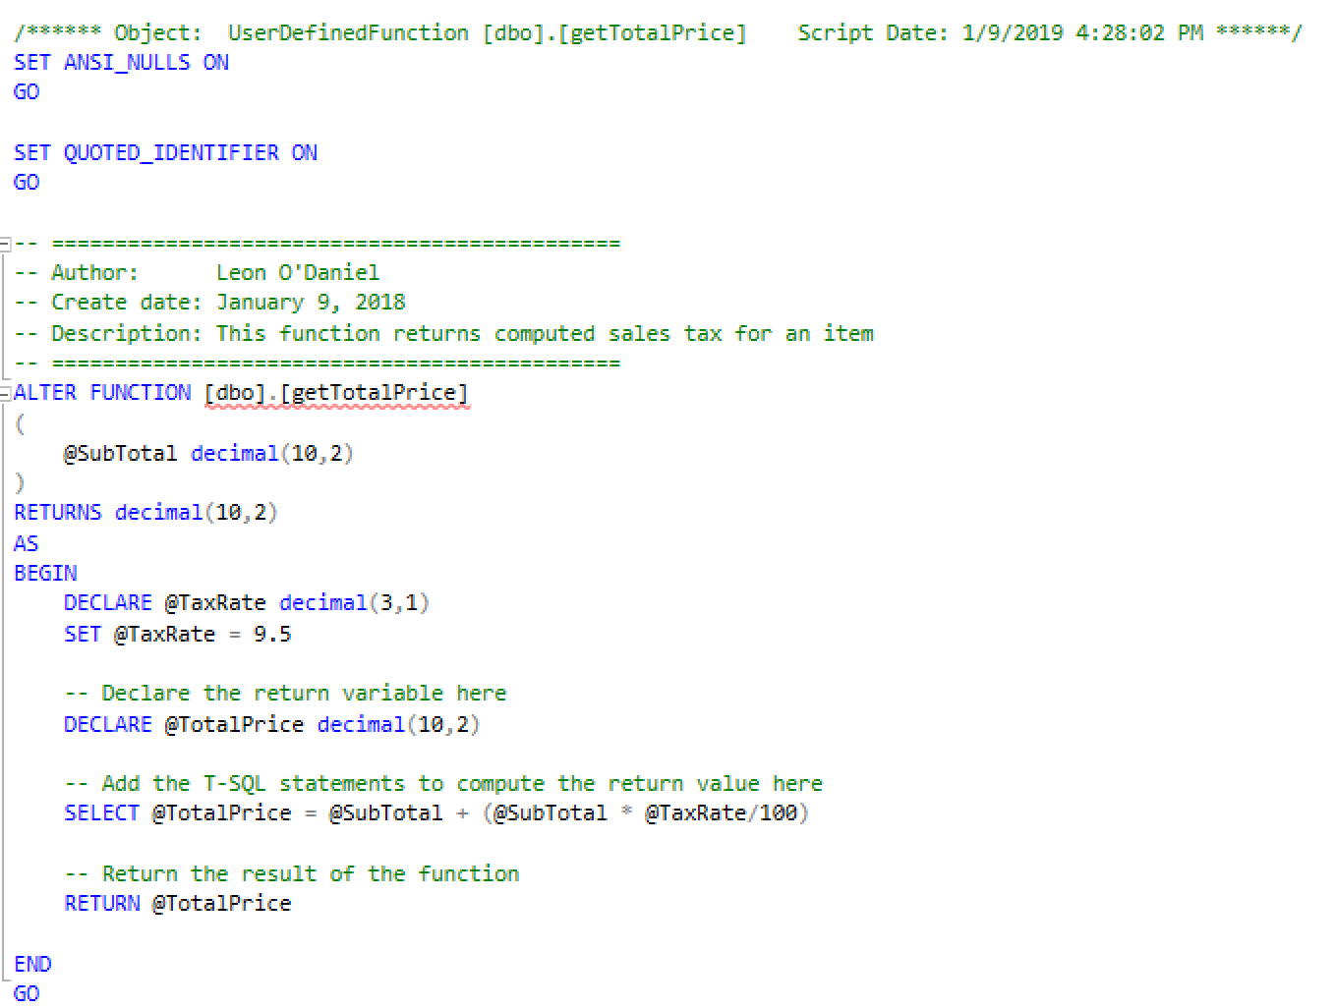
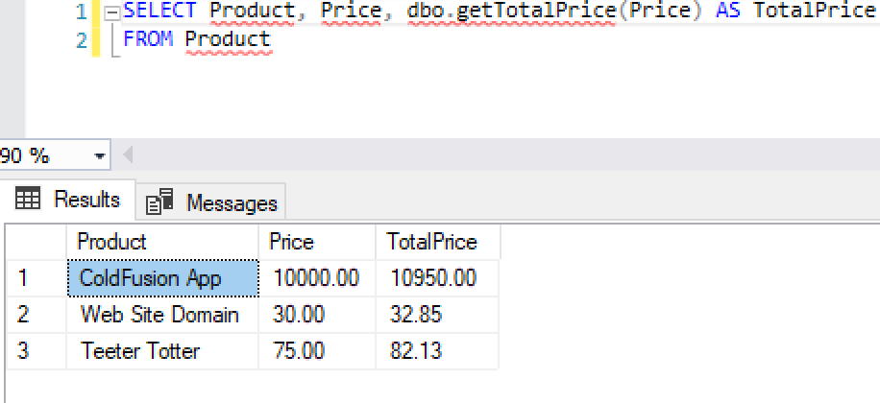
Leveraging Microsoft SQL Server Stored Procedures and Scalar Functions in your CF App
User Defined Scalar Functions

Slide 12
The Importance of Proper Requirements Definition with your Next ColdFusion Project
Dr. David Gilbert

Slide 13
CSS Trick for Alternating Data Grid Row Colors
No longer need to use code like: <cfif tablerecords.currentrow MOD(2)> <tr class=“gray”> <cfelse> <tr class=“lightgray”> </cfif> CSS can handle this!

Slide 14
CSS Trick for Alternating Data Grid Row Colors
<style>
tr:nth-child(odd) {background: #CCC}
tr:nth-child(even) {background: #FFF}
</style> more info:
https://caniuse.com/#feat=css-sel3
https://www.w3.org/Style/Examples/007/evenodd.en.html

Slide 15
Next Month’s Meeting
February 13, 2018 WeWork – Lincoln Square – Bellevue Conference Room 5I Presentation by Vinay Jindal on Debugging your ColdFusion Application using CF Builder

Slide 16
Questions/Answers/Help!

